Slide 1
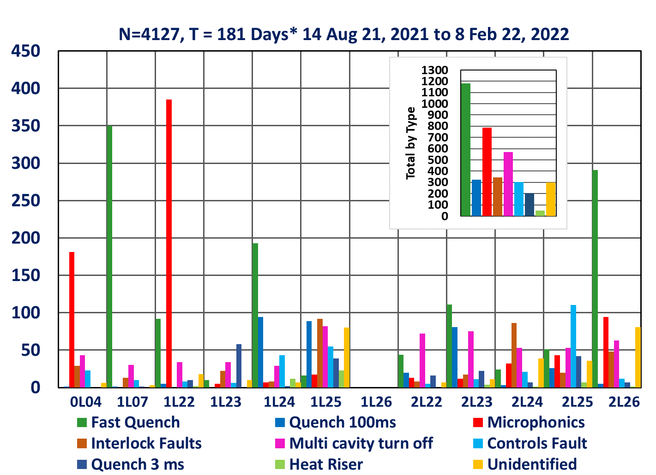
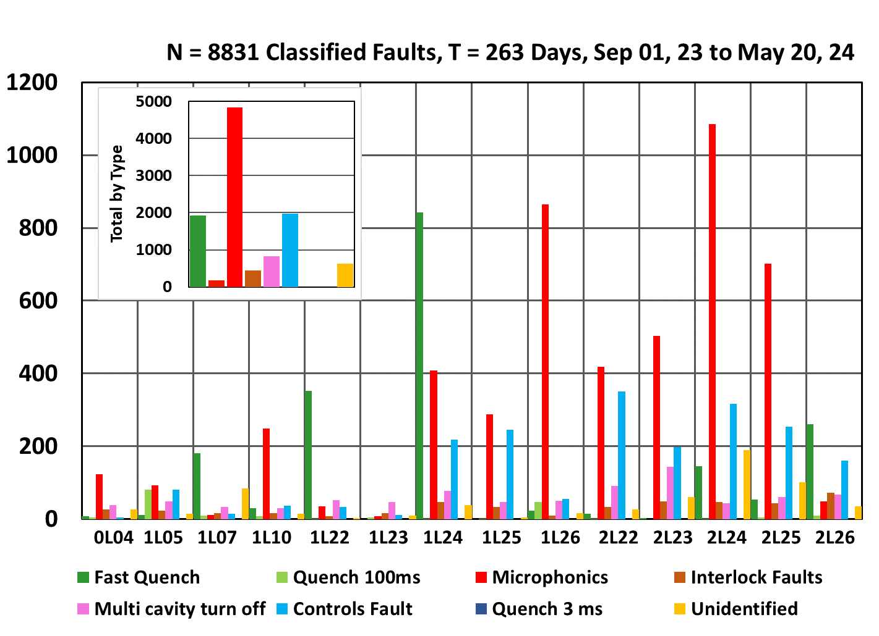
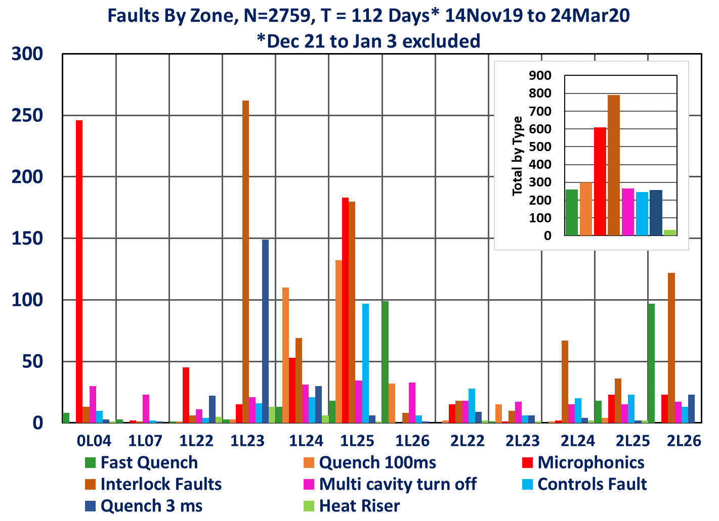
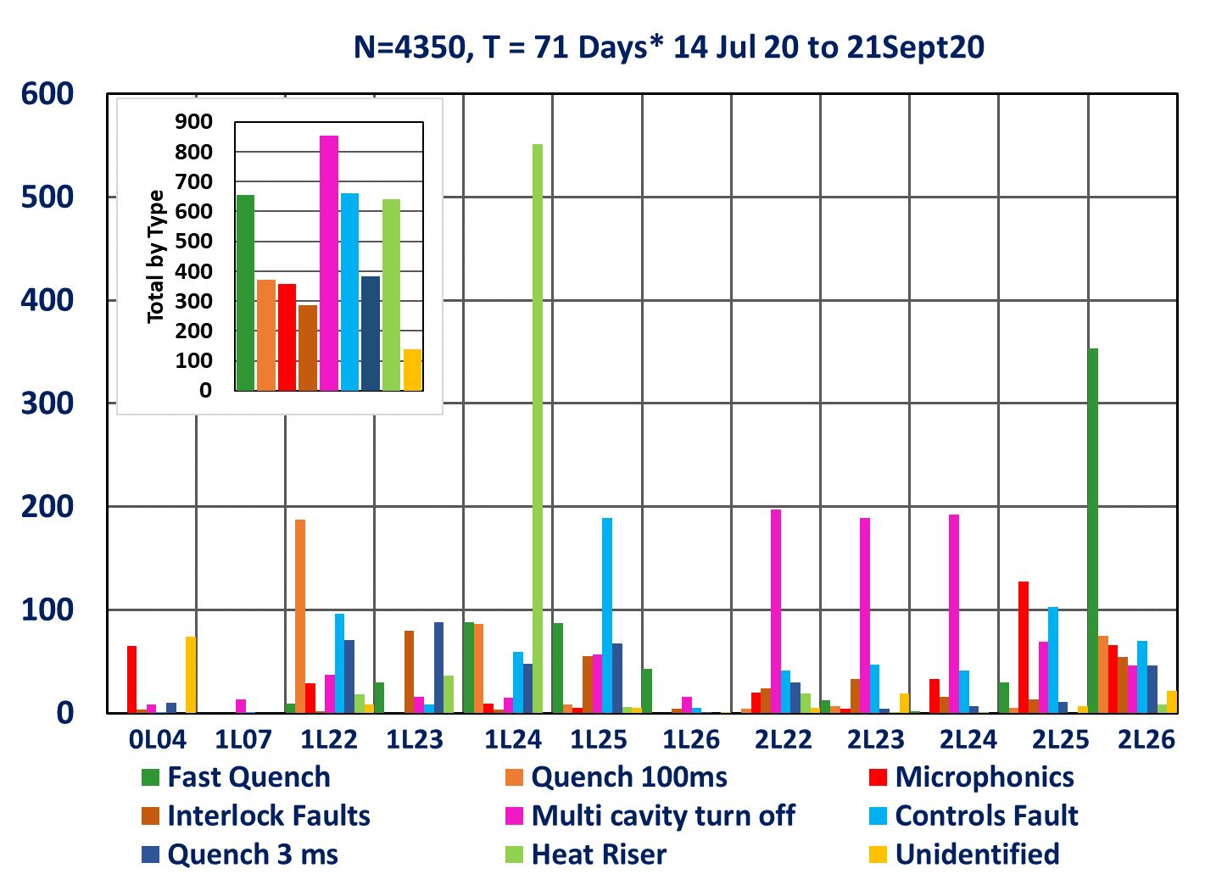
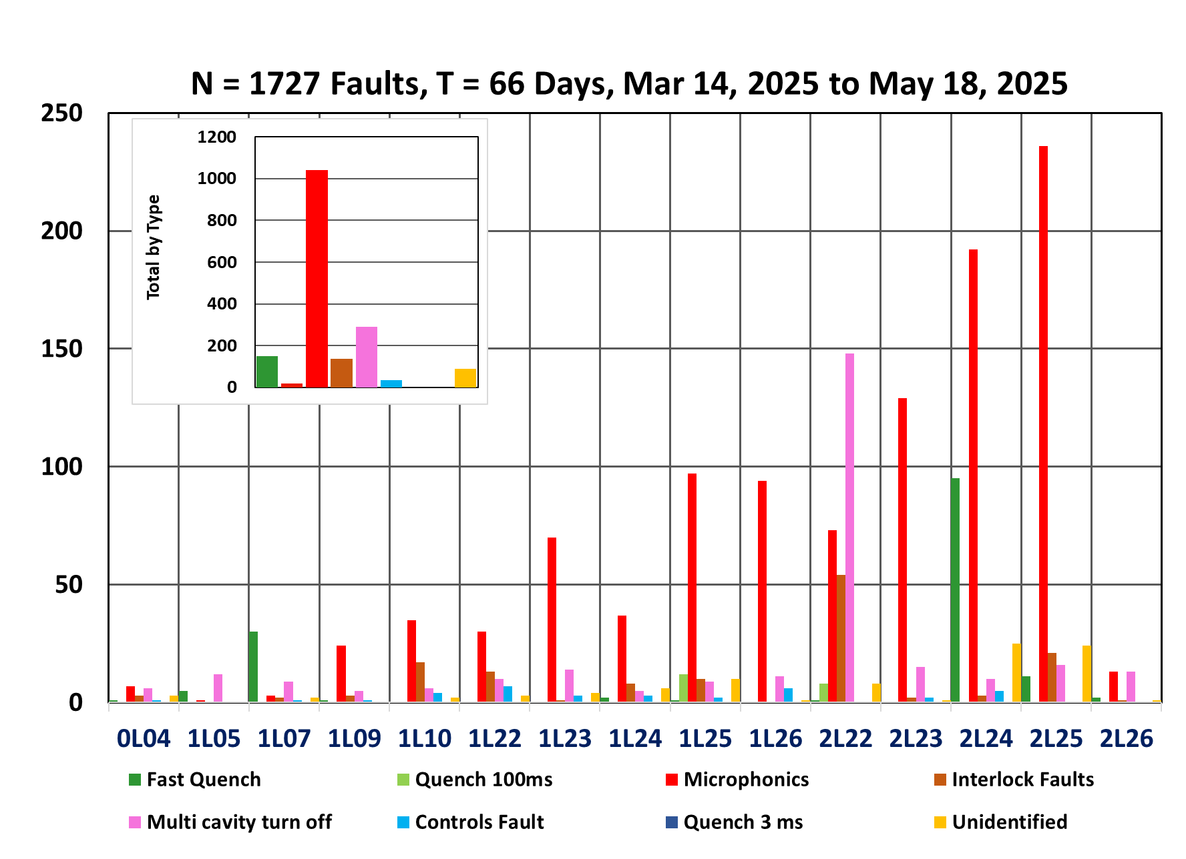
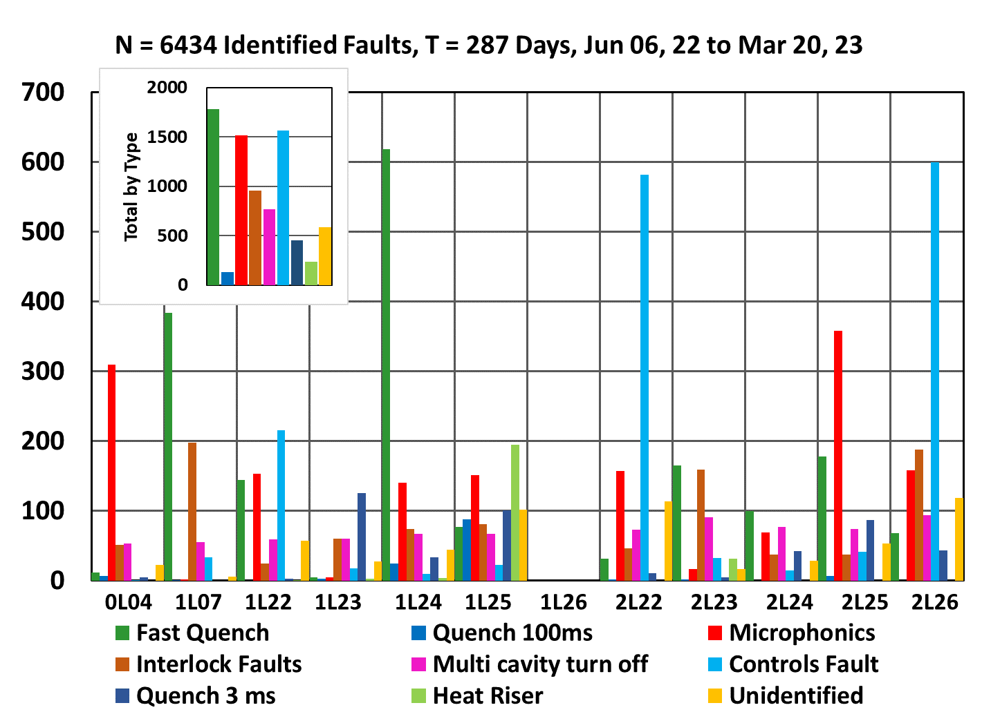
7 6-1/2 years Cavity Faults Based on Time Domain Waveform Records
Tom Powers
14 Oct. 2025
LLRF 2025, Newport News, VA

Slide 2
Why did we do a waveform harvester
Which cavity initiated a given fault.
C100 cryomodules do not have bellows between cavities.
Lorentz forces when a cavity trips off cause microphonic vibrations in a zone
These vibrations will cause secondary cavities to trip off.
Without other information we can not tell what caused the trip or which cavity was first.
In 2018/2019
FPGA firmware was modified to have a ring buffer and to use an external trigger to initiate collection of a waveform record.
External triggering from was set up such that any cavity in a given cryomodule would trigger the other 7 cavities in the zone.
8096 point waveform records of 16 signals are acquired on every fault and saved as a series of data files.
In 2022/23
A second set of buffers was put into the system so that we could gather statistics, etc. on the waveform records without interrupting the harvest waveforms on fault function.
In addition to being available for live display the maximum, minimum, average, and standard deviation of critical signals are acquired several times a second and saved to the machine archiver.
2023
Controls changed from I/Q to SELA/SELAP modes in order to improve recovery time after a trip.

Slide 3
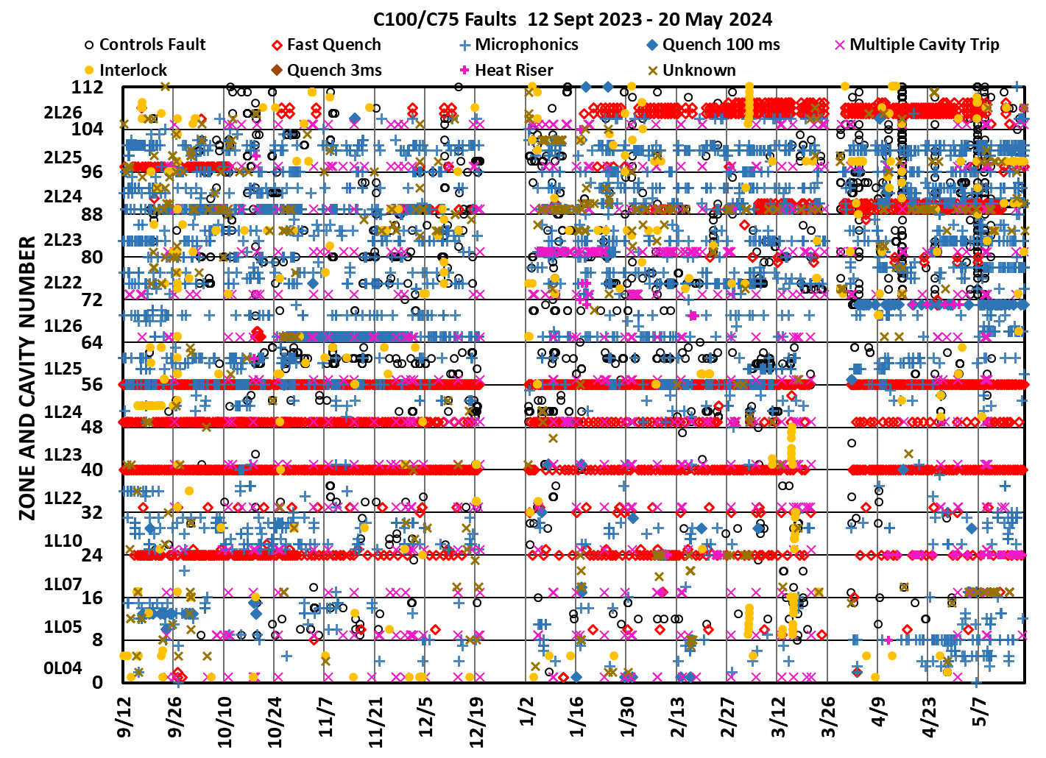
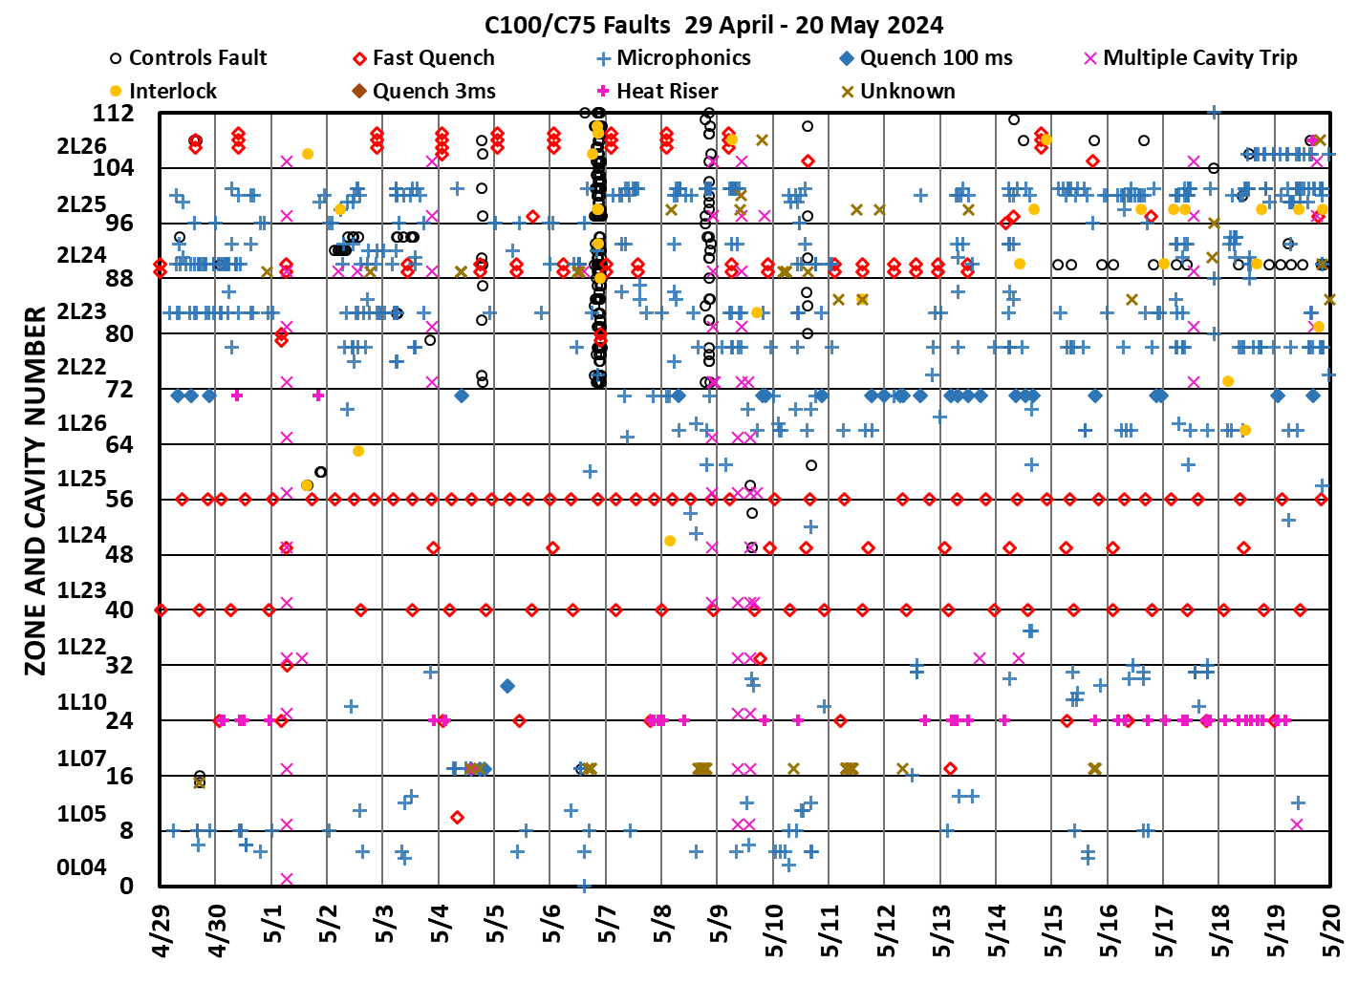
Faults for some recent runs
Fault data discussed by gradient team meeting every 2 or 3 weeks.
Looking back over the run for issues that got worse during the run.

Slide 4
Examples of problems
Excessive number of “microphonics” trips.
MO noise issue driven by thunderstorms. Mitigated with fiber distribution system.
Increases in electronic quenches over time
Fault data discussed by gradient team meeting every 2 or 3 weeks.
Looking back over the run for issues that got worse during the run.

Slide 5
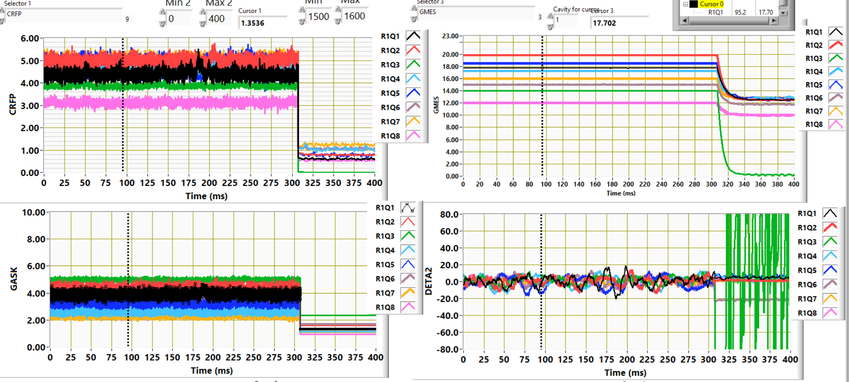
2019 QNCH fault, the trip that was not a fault
RF Power (kW)
Gradient (MV/m)
Modulator Drive “Voltage”
Detune Phase
20% of the faults were labeled as QNCH (quench) faults by the LLRF system.
On all of these faults there was no precursor on the GASK, forward power or forward power phase just before the cavity tripped off.
After some experiments this interlock was bypassed.
The QNCH interlock was completely re-written in the FCC 3.0 firmware.

Slide 6
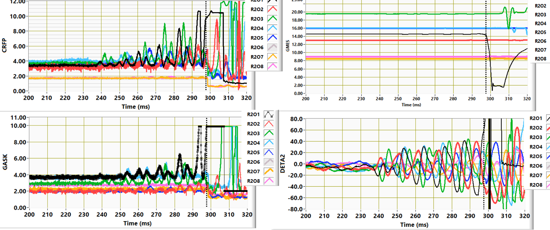
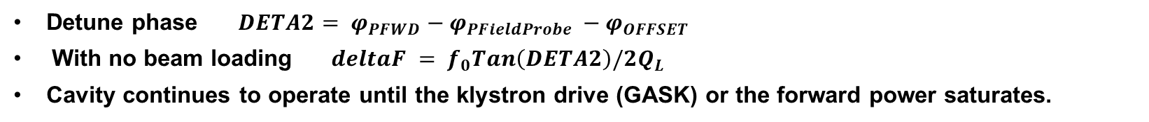
Microphonics trip FCC 2.0 firmware. Things did not trip until system saturated.
RF Power (kW)
Background Microphonics
Transient Microphonics
Gradient (MV/m)
Modulator Drive “Voltage”
Detune Phase
Detune phase ${DETA2= φ}_{PFWD}−φ_{PFieldProbe }−φ_{OFFSET}$
With no beam loading $deltaF = f_{0}Tan\left(DETA2\right)/2Q_{L}$
Cavity continues to operate until the klystron drive (GASK) or the forward power saturates.

Slide 7
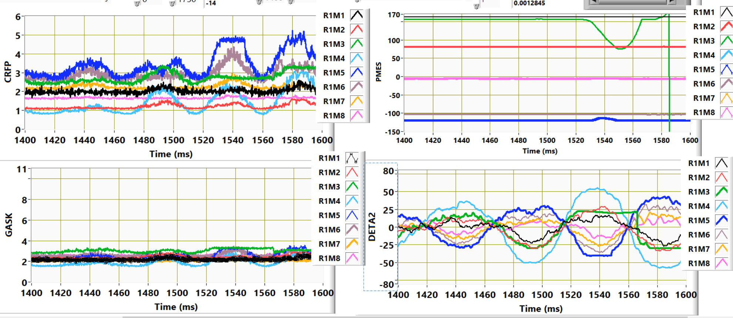
FCC3.0 software loses phase and gradient regulation before RF power saturates
RF Power (kW)
Cavity phase (degrees)
Detune Phase
Modulator Drive “Voltage”
System calculates the power required to compensate for microphonics and limits the “imaginary” drive signal when it is exceeded by a threshold.
Cavity loses phase lock before the modulator drive saturates or before you run out of RF power.
If the detune phase was less than 50° the fault was declared to be a controls fault.

Slide 8
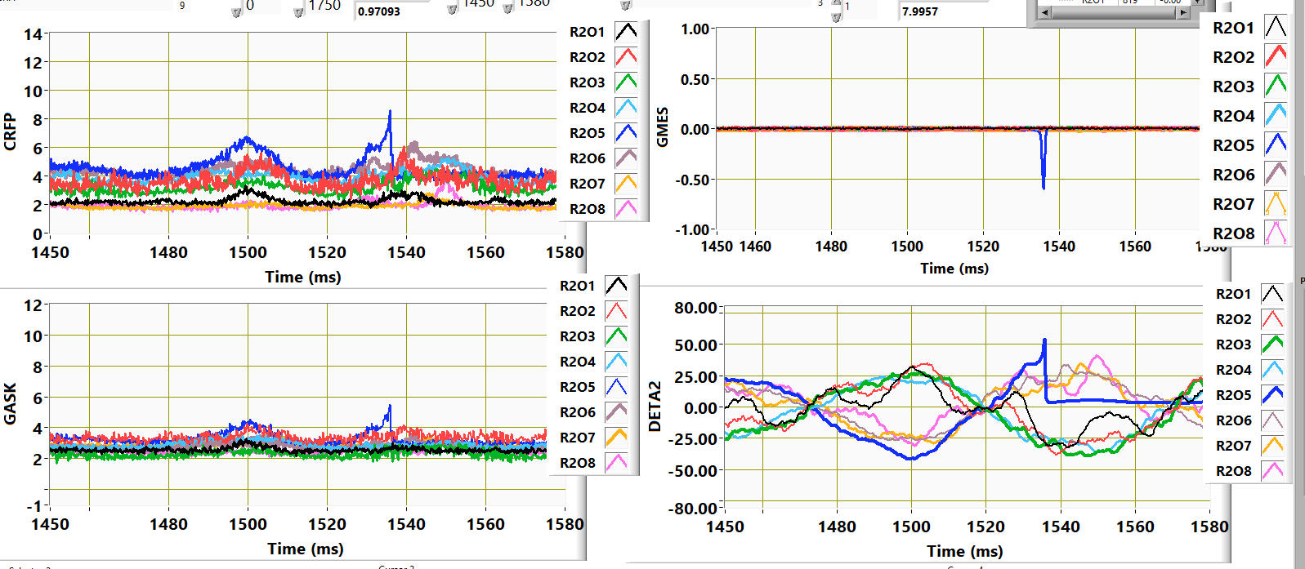
Gradient transient trip likely due to phase margin problems due to klystron phase push
Normal but excessive microphonics.
Controls got “lost” note change in second derivative
This fault is most likely due to phase push on the klystron depeleting the phase margin.
Analysis of energy transients just before beam loss faults, and analysis of lots of waveforms triggered on fast shutdown faults lead to changing the sensitivity of the gradient fault interlock.
Plans are underway to include klystron phase push in algorithm.

Slide 9
2018 and 2025 Data allowed us to do targeted Microphonics hardening of cryomodules
Initial studies centered around microphonics mitigation.
Initial work done in 2018
0L04 was turned up a lot and the microphonic trip rate went up substantially as did several other types of faults.
Microphonic trip rate also went up on 1L24 and 1L25.
Poly Bead Bags added 2L24, 2L25, 2L26
Gradients increased and the trip rates decreased on 2 and remained the same on 2L25
At least two of the microphonic trips on 2L24, 2L25 and 2L26 happened at the same time and were probably driven.
Expanded poly bead bags to other zones.
Currently completing the buildout of adding waveguide struts and damping material to all C100 zones.
Choices of zones for mitigations is data driven.
 | MV per CM |  | Microphonics Trips per Day
Zone | Dec 18 | Feb 18 | Dec 18 | Feb 18
1L26 | 87.92 | 85.26 | 0.12 | 0.06
2L22 | 90.86 | 90.86 | 0.20 | 0.00
2L23 | 78.4 | 78.26 | 0.05 | 0.00
2L24 | 67.55 | 77.35 | 0.45 | 0.12
2L25 | 77 | 86.31 | 0.45 | 0.41
2L26 | 92.68 | 99.47 | 0.71 | 0.18
total | 813.19 | 851.55
NL | 406.7 | 419.3
SL | 406.49 | 432.25

Slide 10
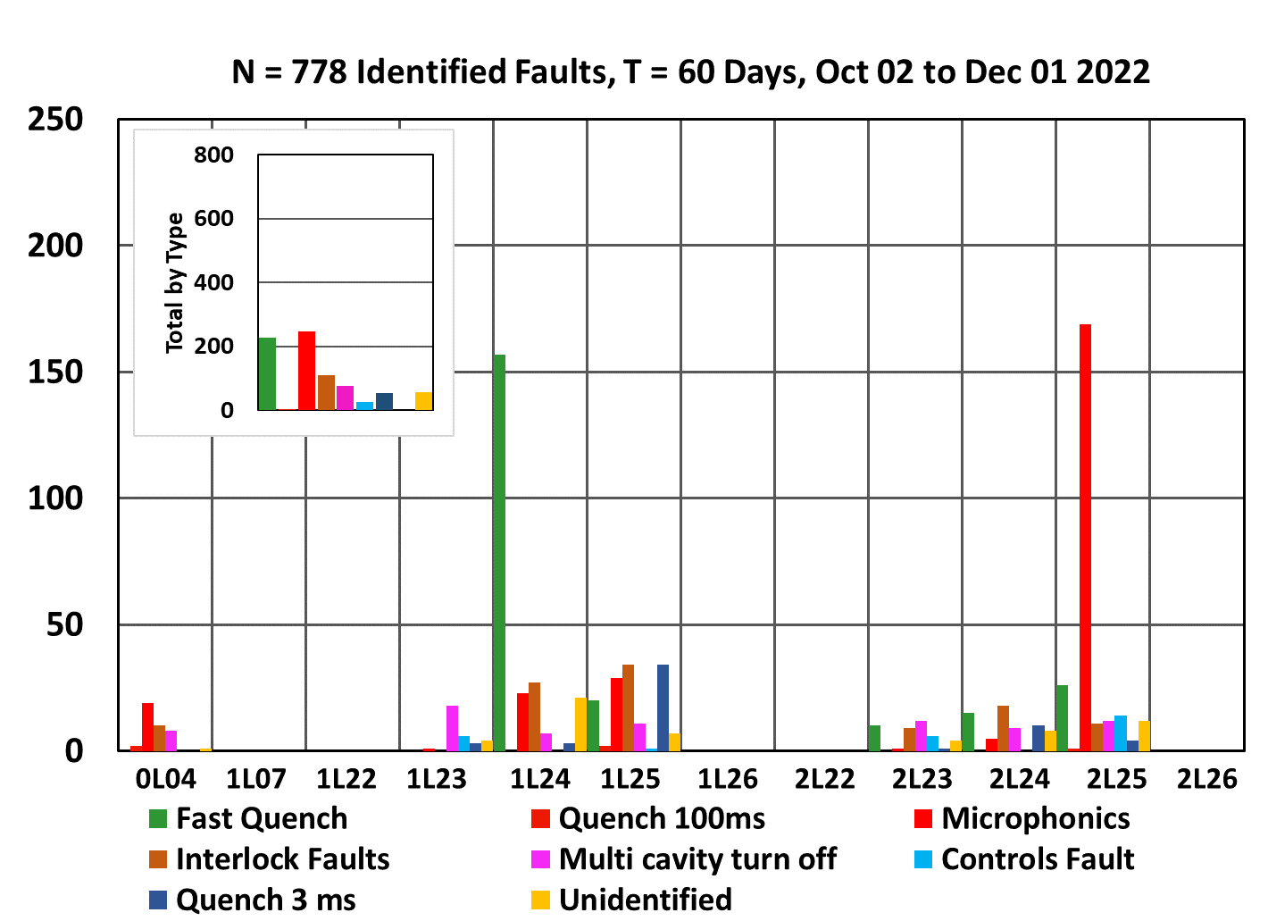
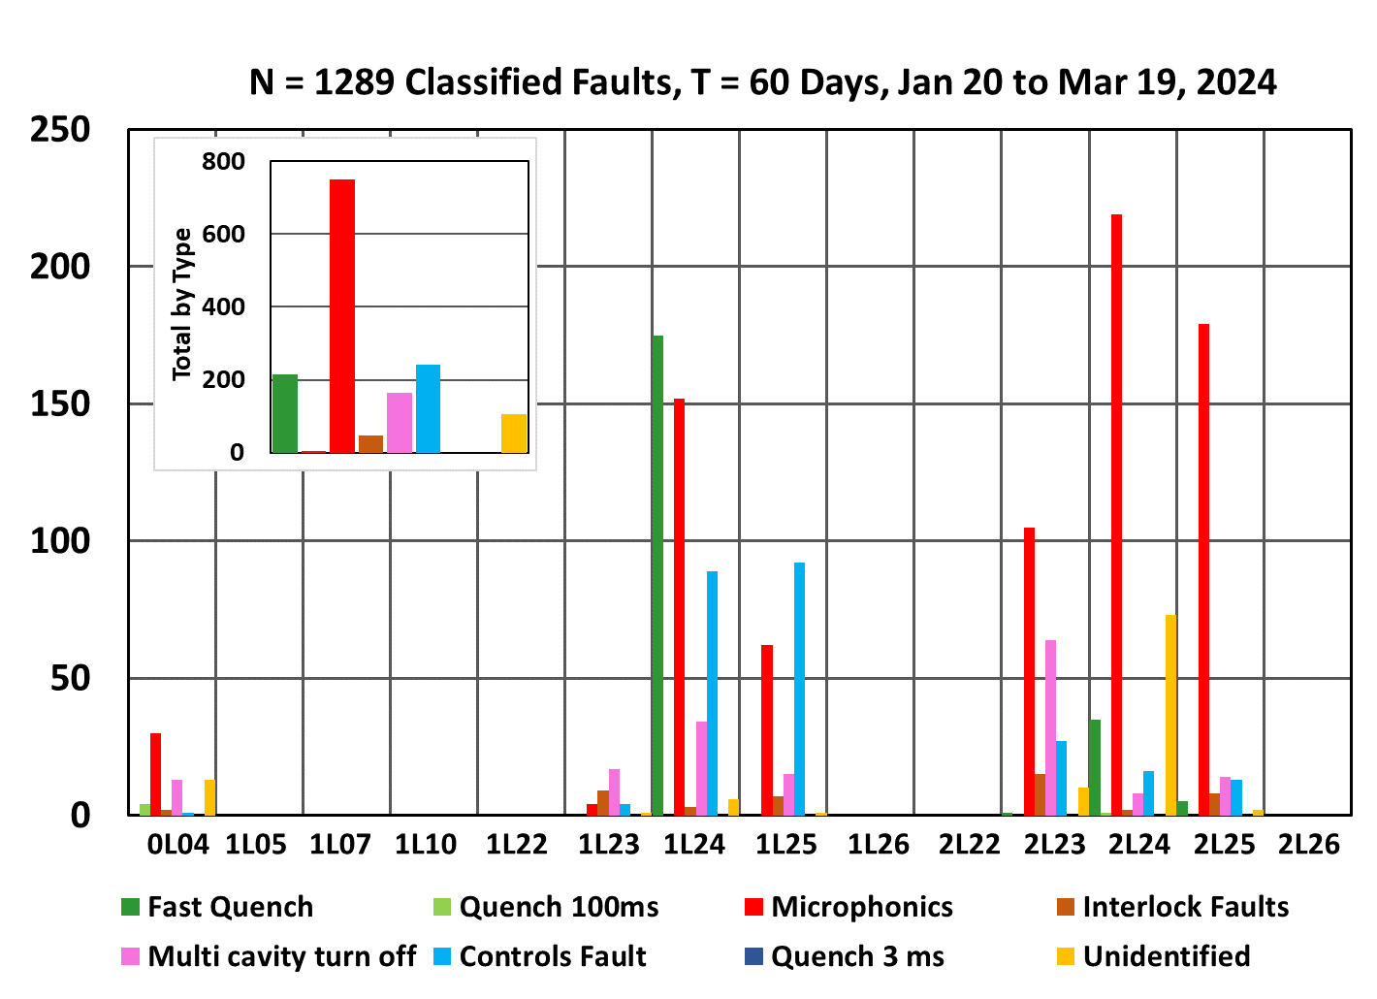
Trips for zones that went from FCC 2.0 to FCC 3.0 firmware
112 / 110 MeV
144/124.5 MeV
135/144 MeV
126/153 MeV
126/131 MeV
144/124.5 MeV
115 / 95.3 MeV
112 / 110 MeV
135/144 MeV
126/153 MeV
115 / 95.3 MeV
126/131 MeV
118/120 MeV
118/120 MeV
Data shown only includes zones that went from FCC 2.0 to FCC 3.0 software.
First energy from 11 Nov 2022, second from 17 March 2024
3 zones in the NL got turned down yet they had more microphonics and controls trips.
3 zones in the SL got turned up and had more microphonics and controls trips.
Controls and microphonics trips over 60 days went from about 250 to about 1000.
Problem identified so that it could be investigated by LLRF group things did improve during the run.

Slide 11
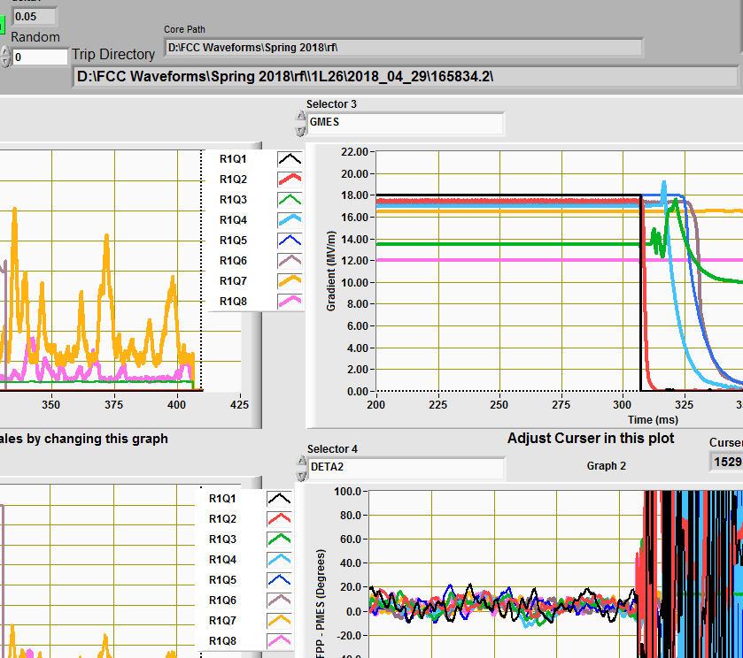
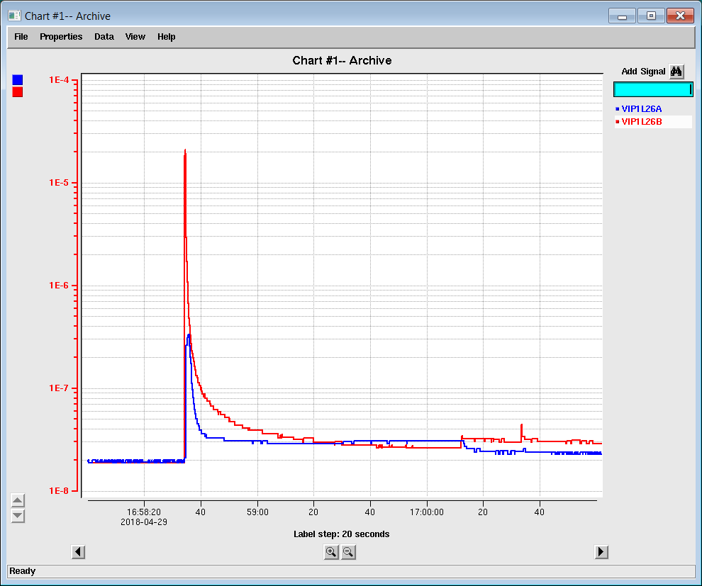
Fast “Electronic Quench”
Fall time of cavity gradient faster than 50 us (one point at this acquisition rate).
Cavity seemed to be operating normally up until this point.
Theory -- vacuum burst in cavity releases large quantities of electrons which absorb the energy within the cavity.
93% of the fast quenches in the Fall 2018 run were in cavities 1 or 8 the rest were distributed between the other 6.
Extensive leak checking was done without finding a problem. FE radiation induced photo-desorbtion is likely.
Gradient MV/m
Detune Phase
2e-5 Torr
Corresponding beamline vacuum excursion.
Red trace is pump next to cavity 1 blue trace is at the upstream end of the girder.
Peak vacuum signal adjacent to cavity 2e-5 Torr at the other end of the girder was 3e-7 Torr.
No events were recorded where cavity 1 in one zone and cavity 8 in the adjacent zone had the same fault at the same time which indicates that the event was not due to a vacuum burst in the girder between the cryomodules.

Slide 12
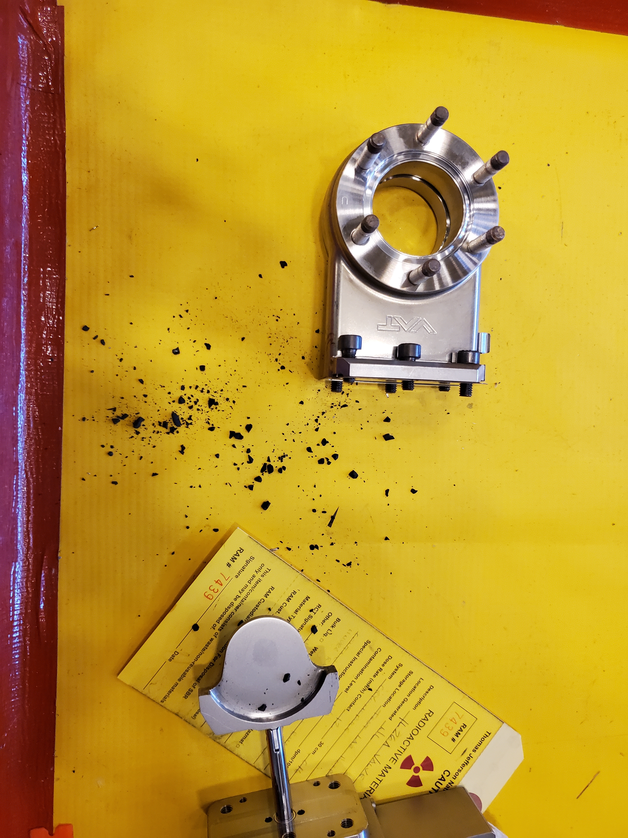
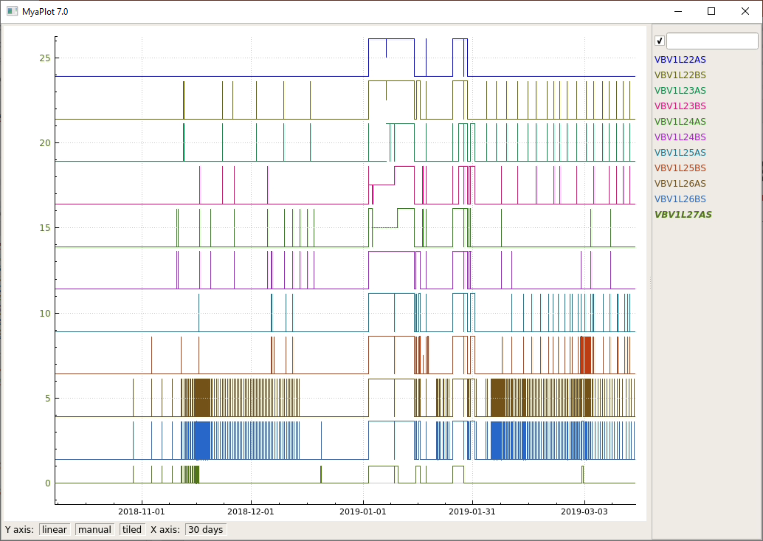
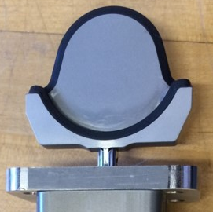
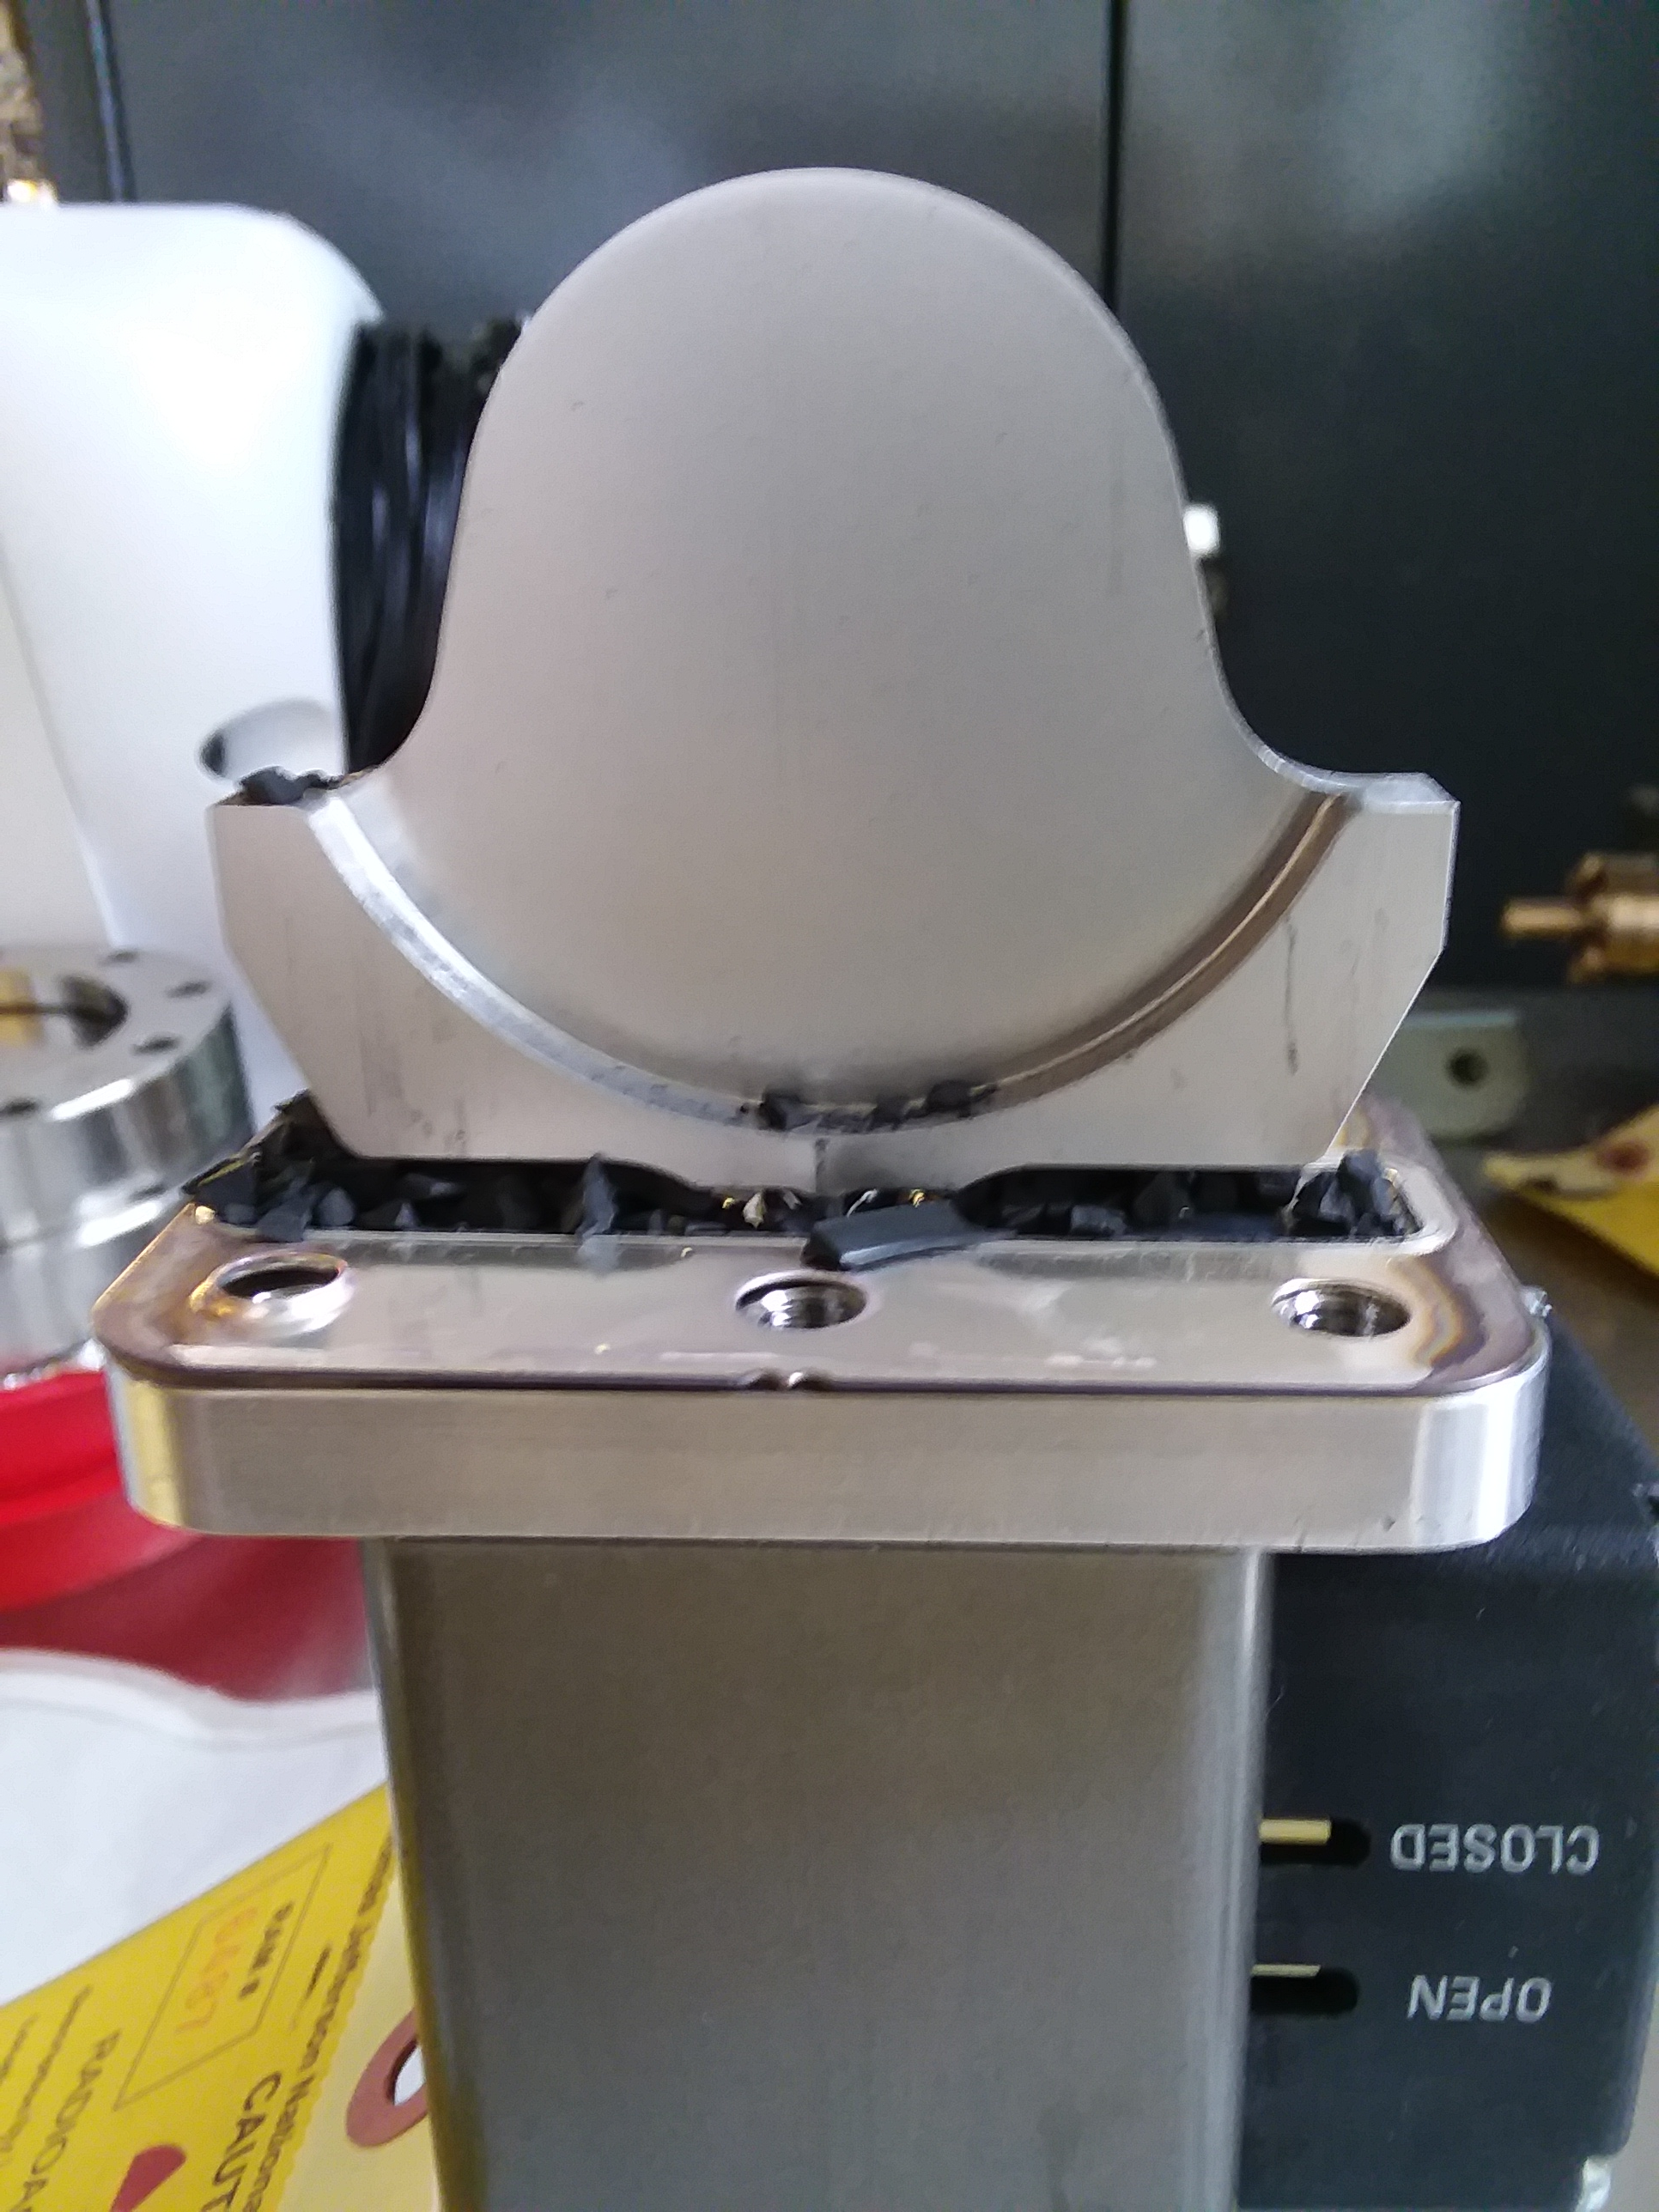
North Linac Vacuum Valve Signals 7Oct18 – 16Mar19
In March 2019 the valve 2L26A failed catastrophically when the Viton seal material, which had been radiation hardened, shattered. In May 2019 the valve at 2L26B also failed.
In both cases the Viton particles go into the cryomodule
The cavity adjacent to the failed valve was inoperable.
The next two cavities had to be operated with substantially reduced gradients.
Once the failure of 2L26A was diagnosed the C100 beam line valves were locked into an open position until we could modify the interlocks such that the valves did not close on a transient vacuum outburst.
This down we started a program to replace all of these valves with metal sealed valves.
1L25
1L26
2018-10-7
2019-3-16
Hardware interlock in ion pump power supply When the pressure exceeds 1e-6 Torr, both the beam line valve(s) close. (1 is close 0 is open)
1L25 and 1L26 had an excessive number of electronic quenches with associated valve closures.

Slide 13
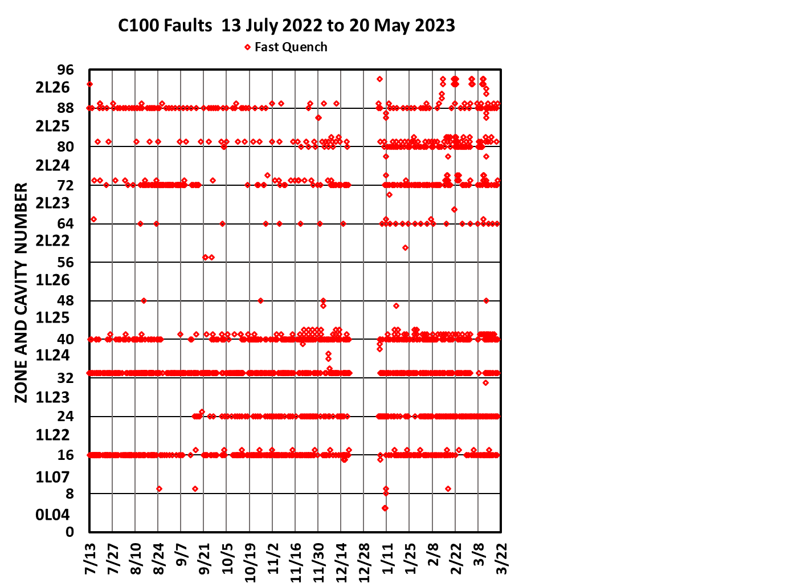
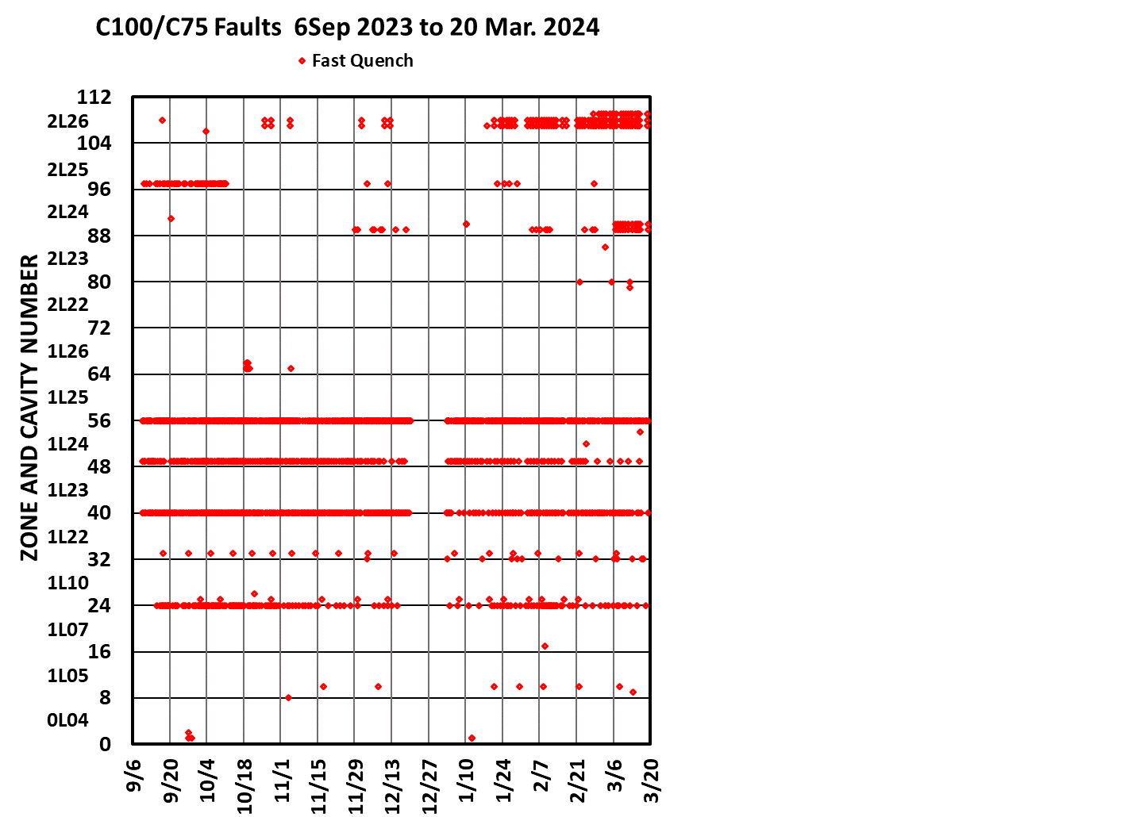
The Reduction in electronic quenches after thermally cycling to 300 K
Replaced
300 K
300 K
300 K
300 K
300 K

Slide 14
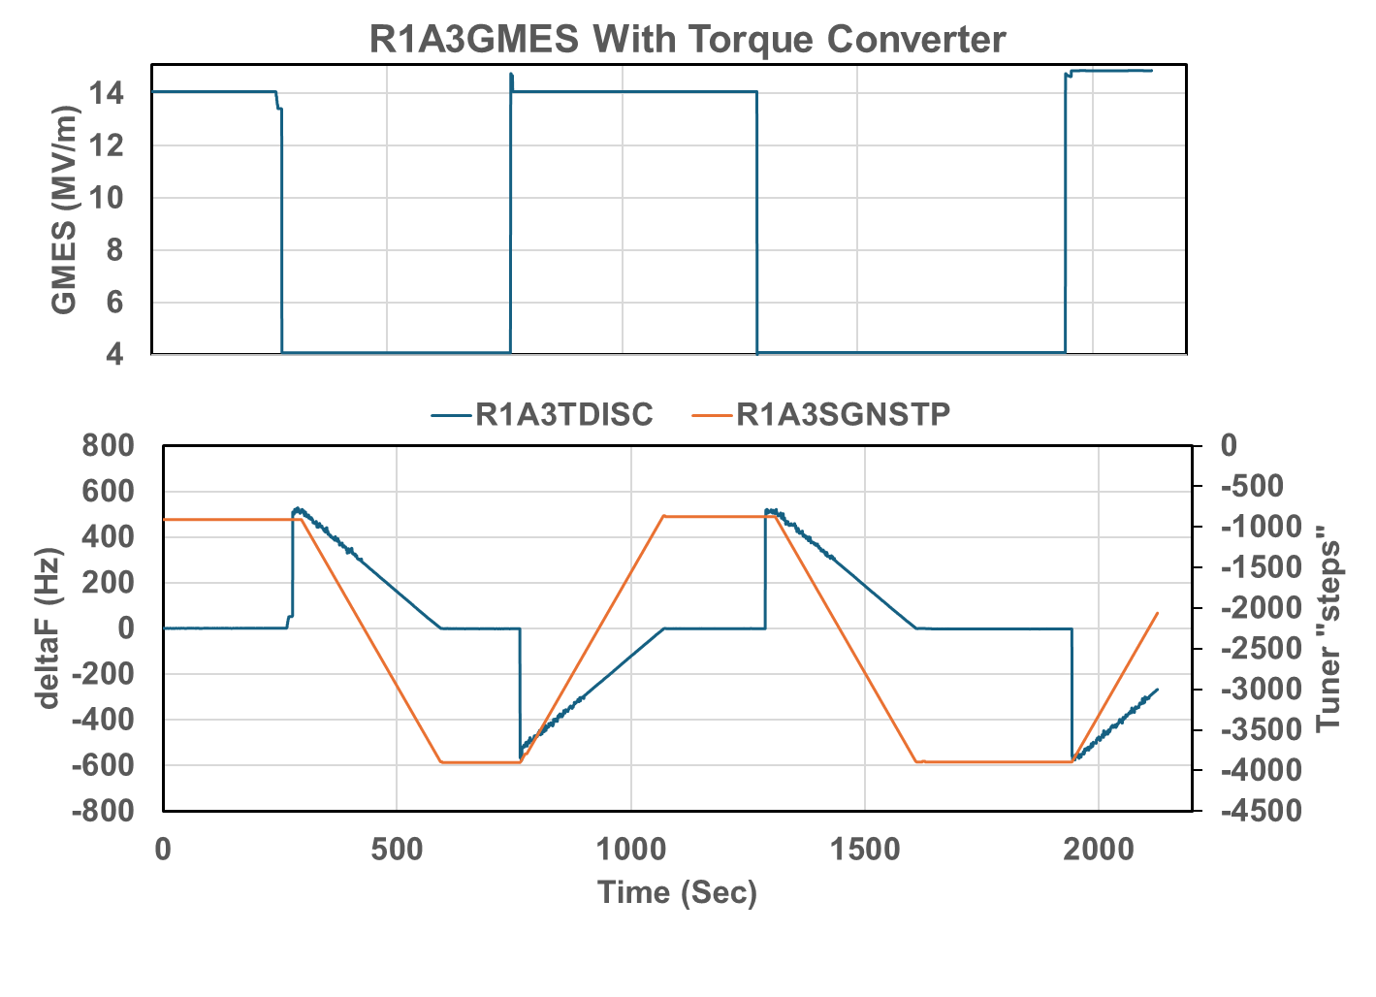
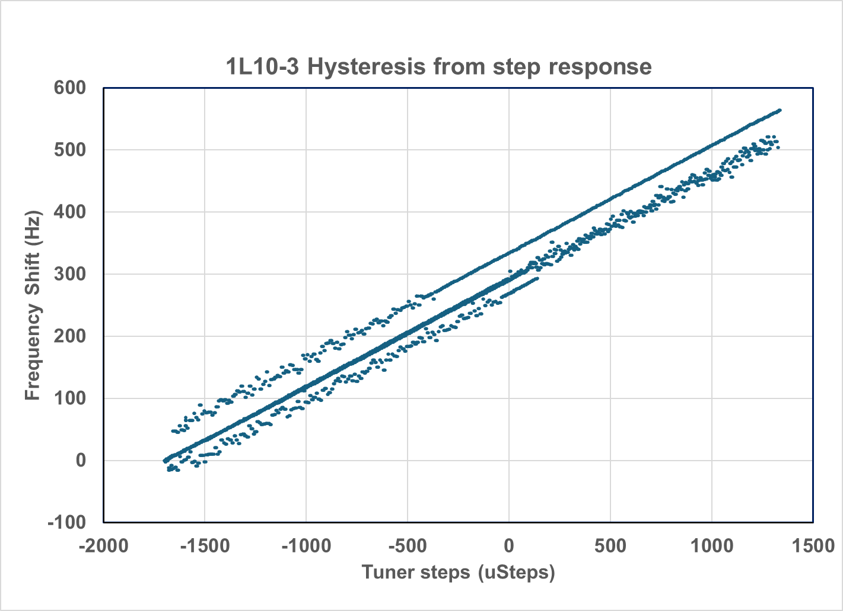
This is your tuner behaving nicely
C75-02
SEL (frequency tracking mode)
Disable tuner (Orange trace on lower plot)
Transition gradient up or down where Lorentz detuning causes a frequency shift (blue trace on lower plot)
Re-enable tuner and wait for cavity to tune.
Observe tuner behavior.
In this case the tuner has a nice linear response.

Slide 15
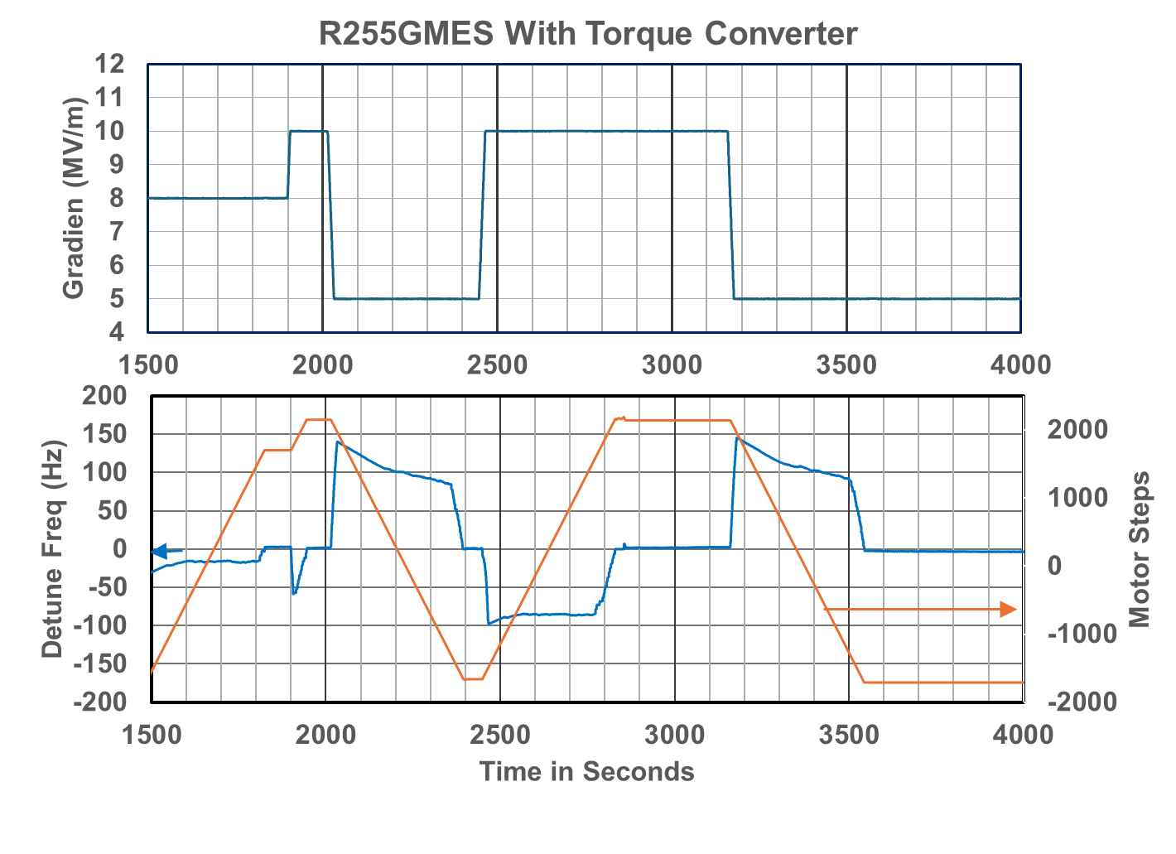
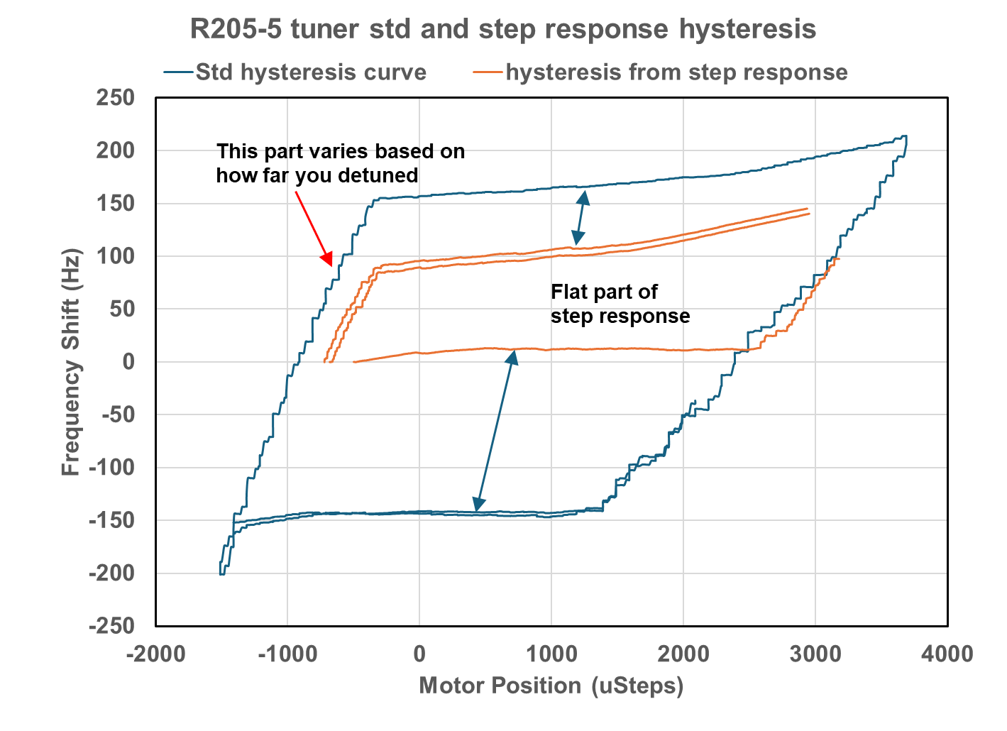
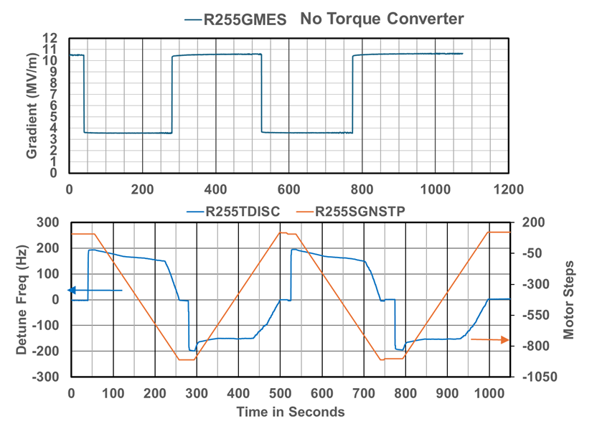
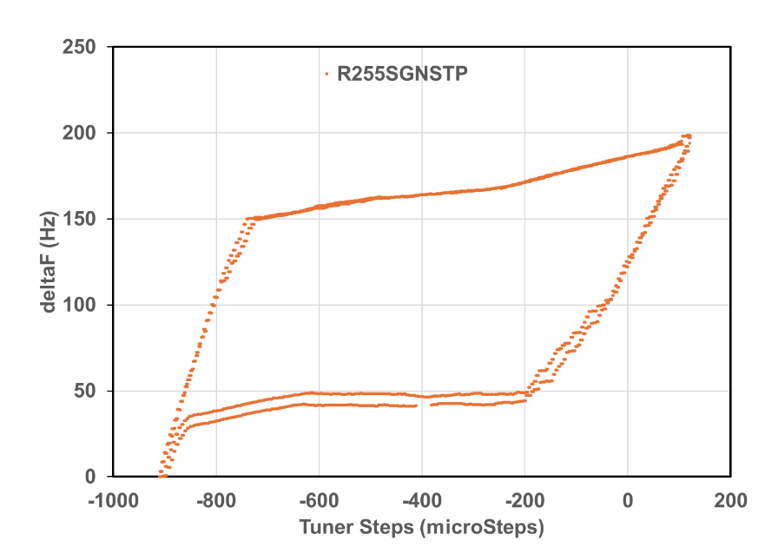
Comparison of hysteresis plots to tuner step responses
Folks normally do hysteresis measurements when they characterize tuners.
At JLAB we do +/-200 kHz followed by +/4 kHz loops during commissioning.
At least the upper plots have the frequency is moving in the correct direction . . . most of the time.
The lower plot has the frequency moving slightly negatively when it is being driven in a positive direction.
Operations see a cavity that is not tuning and bypass it.
LLRF guys get way confused.

Slide 16
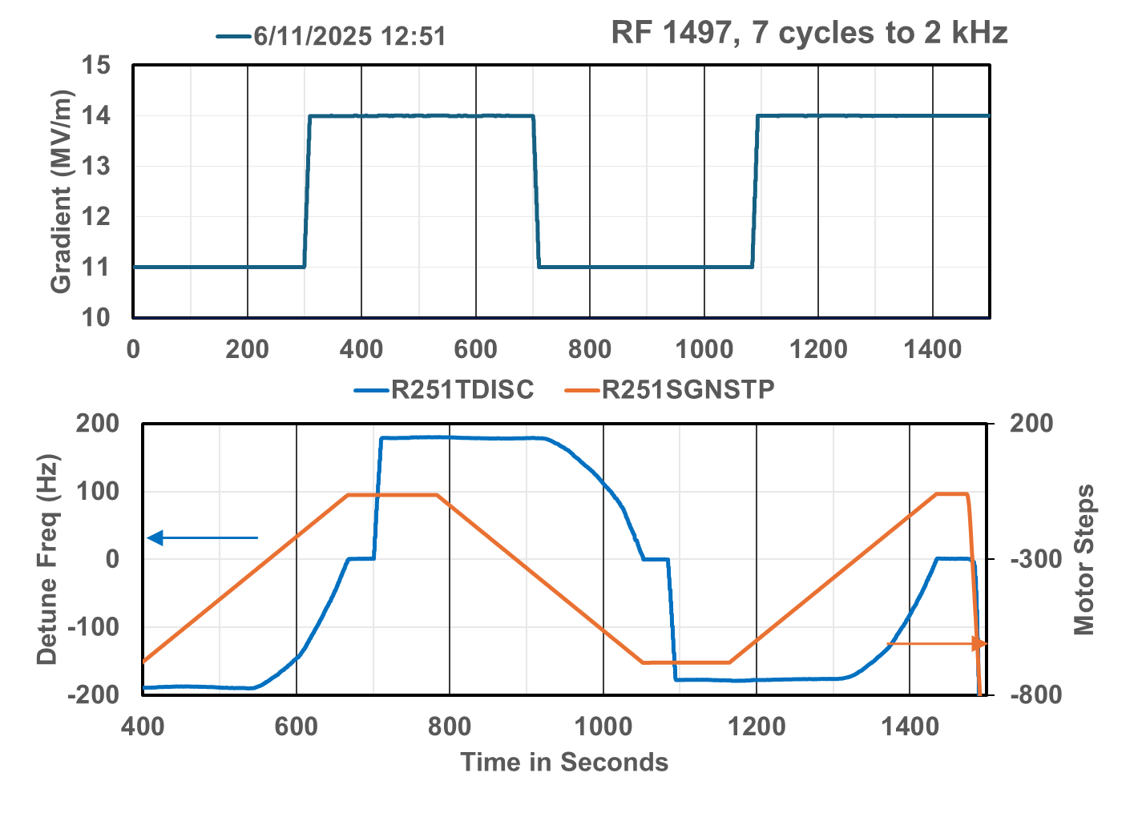
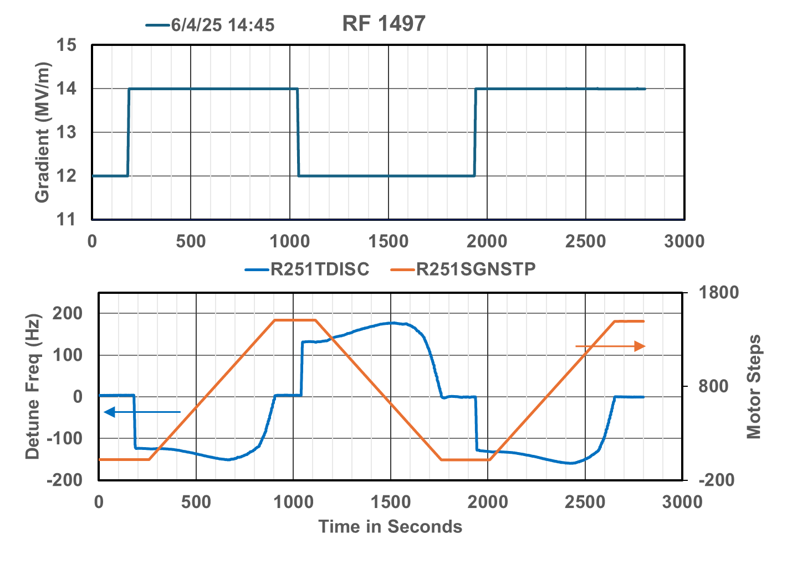
Cavity 2L05-1 (a month before) and after cycling -150-ish kHz and back.
After cycling down to -150 kHz and back (trying to identify transition between tension and compression)
Afterwards he tuner response was completely different
Has negative the detune frequency response.
Takes 2000 micro-steps to tune 100 Hz as compared to 200 steps to tune 50 Hz before. Most of the extra is getting past the “dead band”.

Slide 17
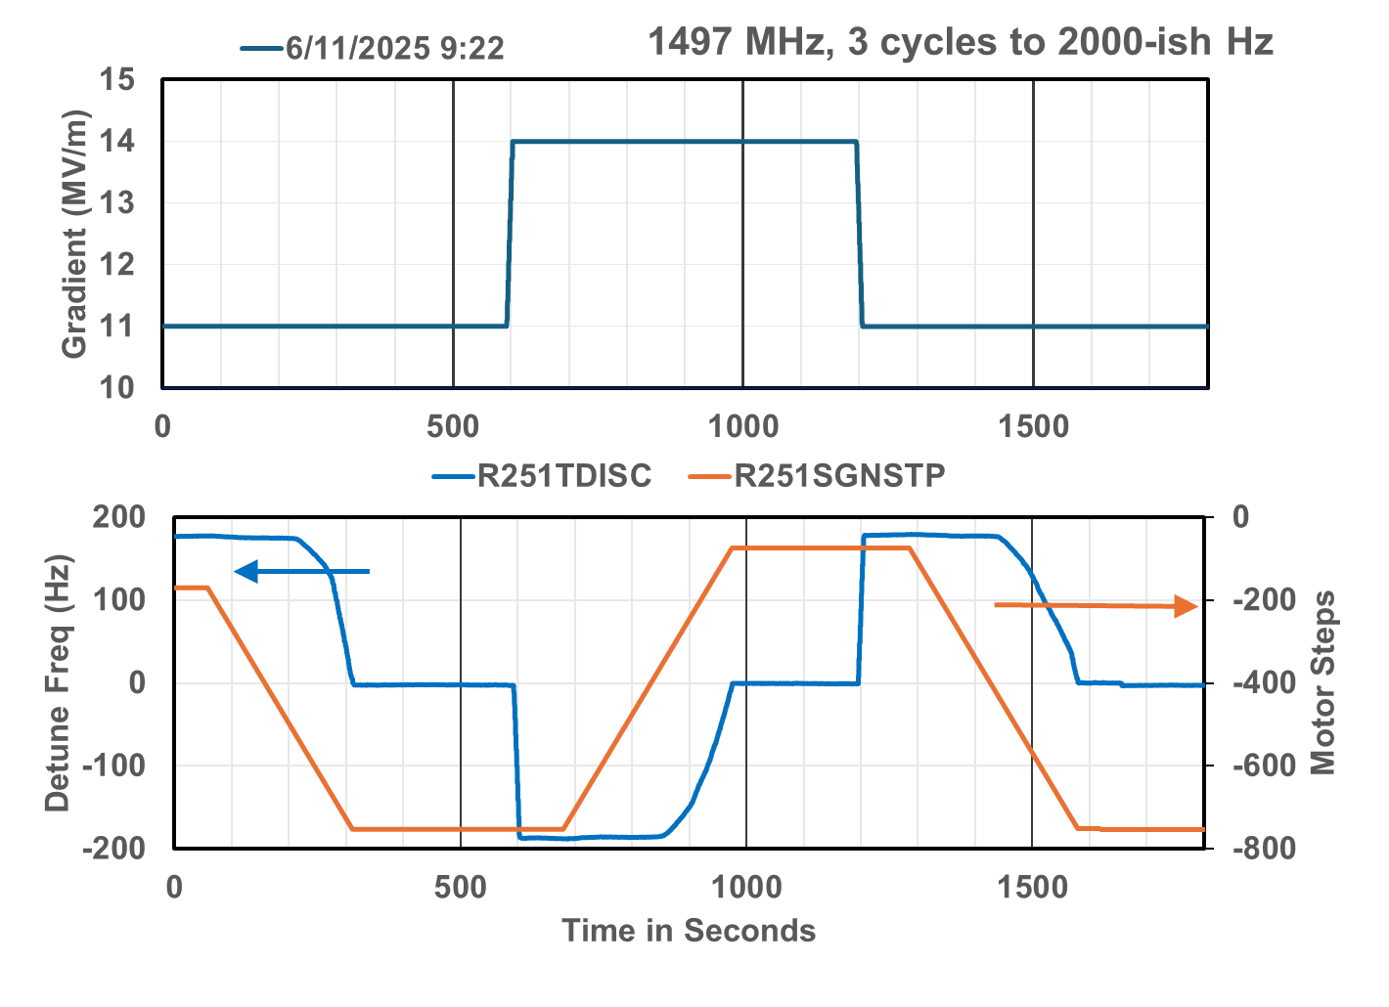
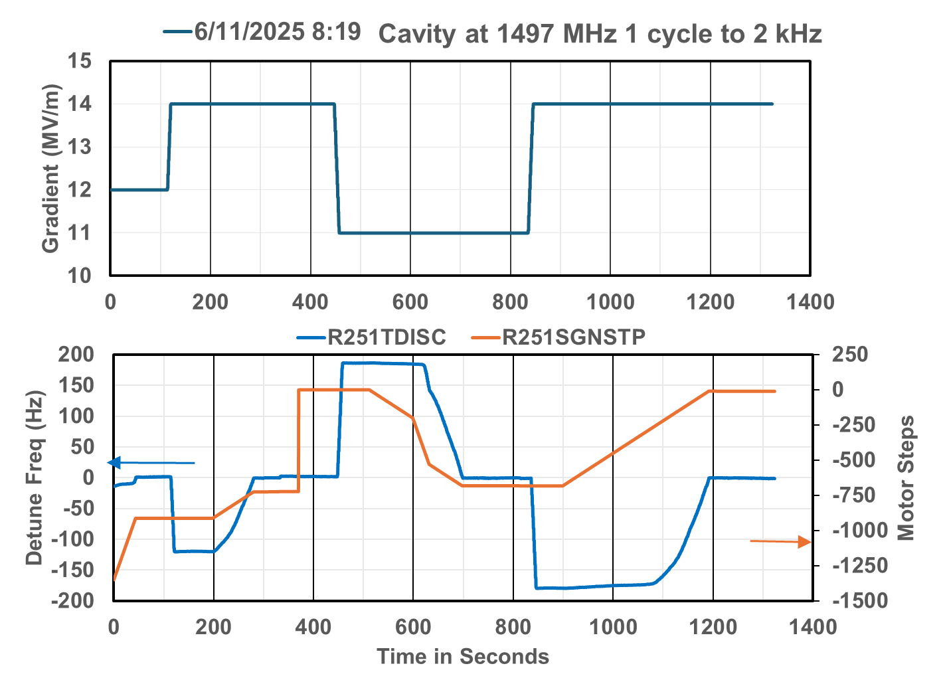
The effect of cycling the tuner +/- 3 kHz multiple times
7 Cycles
3 Cycles
9 Cycles
5 Cycles
1 Cycle
Went from 660 steps for 180 Hz to 480 steps for 200 Hz between 1 cycle and 9 cycles.
More cycles made it slightly better.
We are implementing an automated method to cycle the tuner and make step response measurements
It will be interesting to see what happens after we cycled all of the cavities to 4K and back to 2K

Slide 18
Summary
We have been using RF waveforms to understand the faults in C100 cavities. First year single cavities second and subsequent years all cavities in a zone triggered when any cavity in the zone tripped.
We are able to determine both the cause of the fault and the cavity that initiated the fault.
Machine learning is being applied to the problem.
The waveform records are available to the operators using a web based interface.
The vacuum system interlocks were modified to not close beam line valves on a short vacuum transient
The waveform records are used after the fact by system experts to validate if operations identified the proper fault type and initiating cavity.
We use the data to
Reduce the number of trips per shift by adjusting cavity gradients,
Do targeted upgrades to the cryomodules in order to reduce specific faults.
Validate RF interlock functionality,
Track gas loading issues and when we need to thermally cycle cryomodules to 300 K.
The data was coupled with an energy transient measurement system and used to determine the margins for phase and amplitude errors which should cause an interlock fault.
Although we do not understand the changes in the tuner step response we have a method to improve it.

Slide 19
Backup Slides

Slide 20
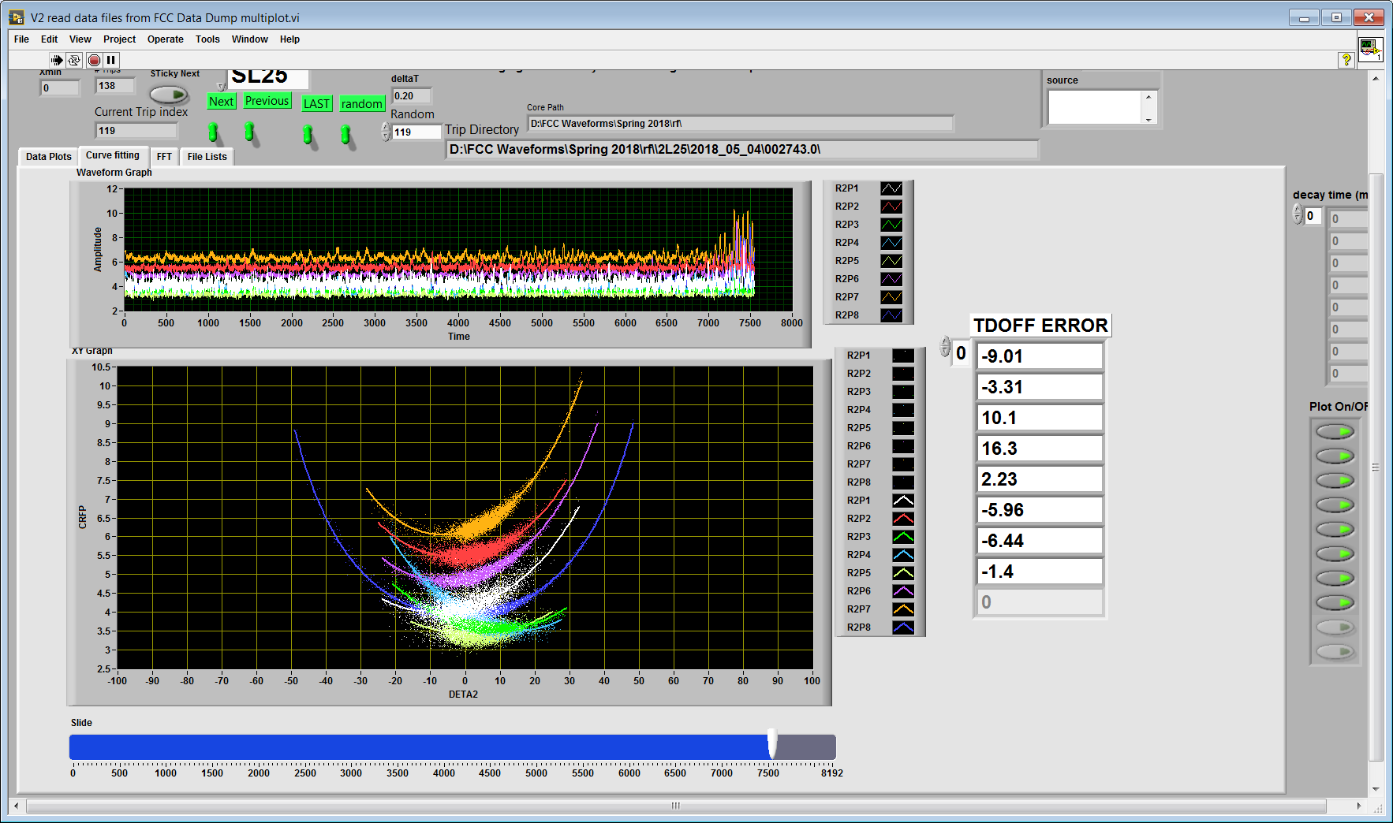
Detune Errors on 31 Oct.
Data was compiled by looking at the waveforms from the trip data.
Data was passed on to LLRF group. Clyde and Rama made adjustments to the worst of the lot.
About a month ago Rama and I developed a spec for the software group on how to automate this. It is not clear if it has priority or not. He provided it to the software group who edited it and returned it to him this past week.
In my opinion we should be keeping the detune within 3 degrees of optimum and should be looking out for TDOFF values that shift which indicate a probable mechanical problem with the cabling or hardware.

Slide 21
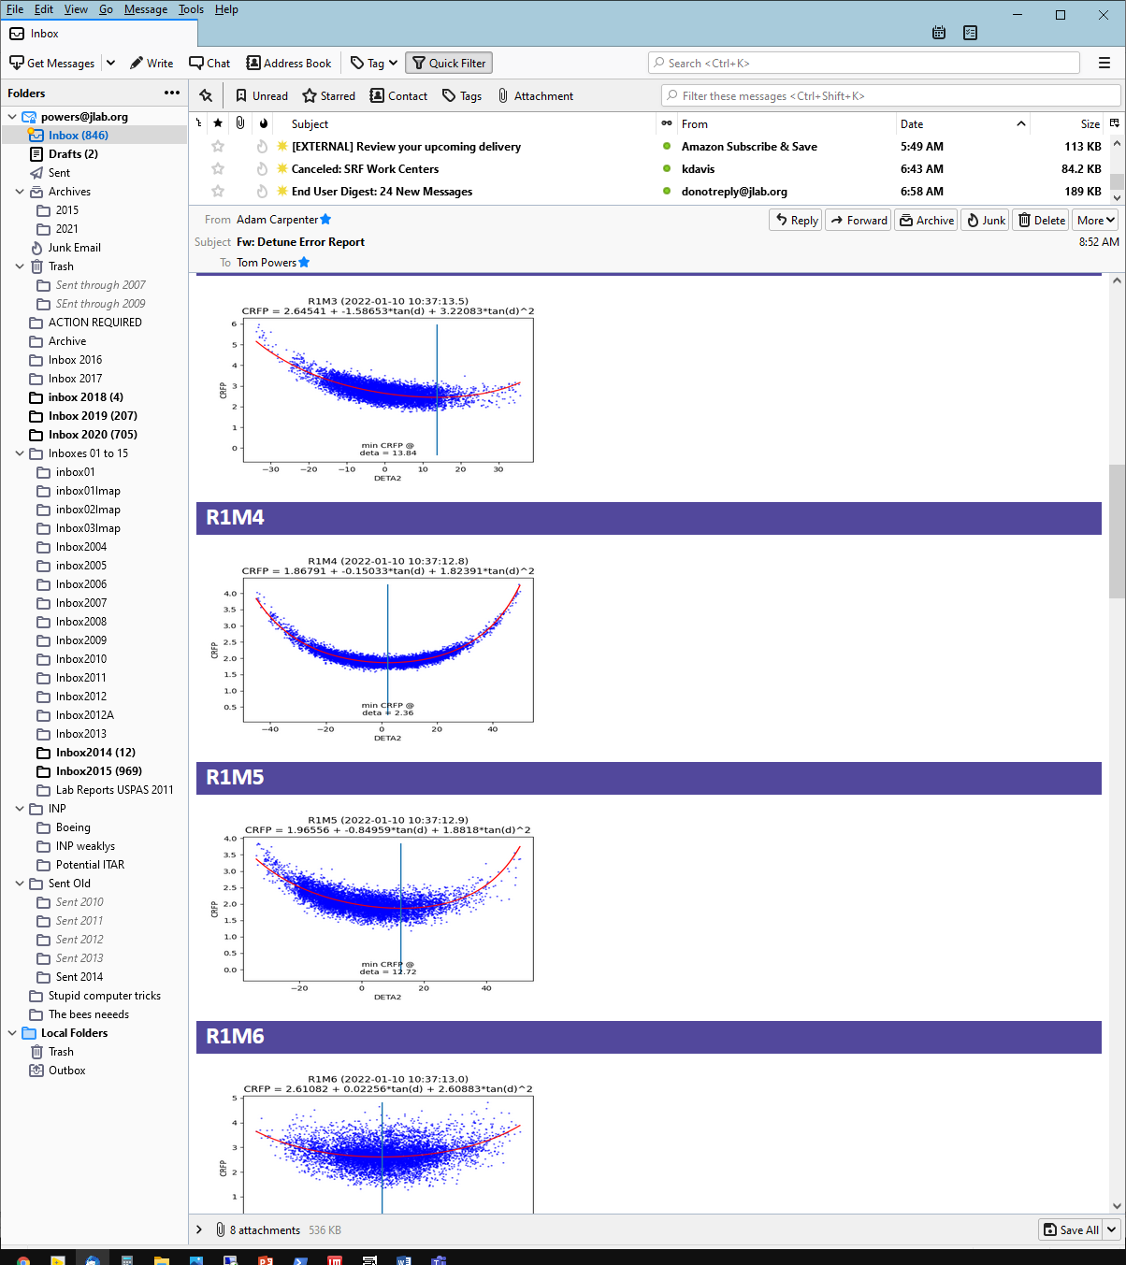
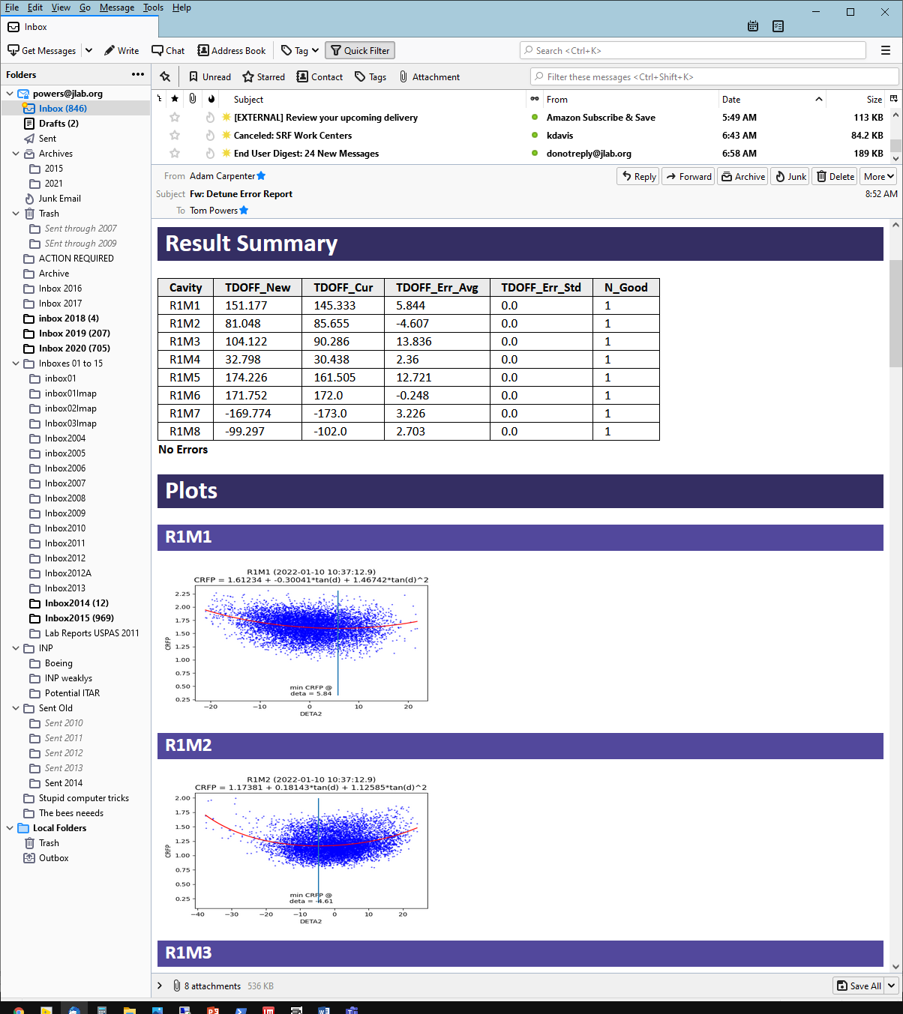
Email report from new tool

Slide 22
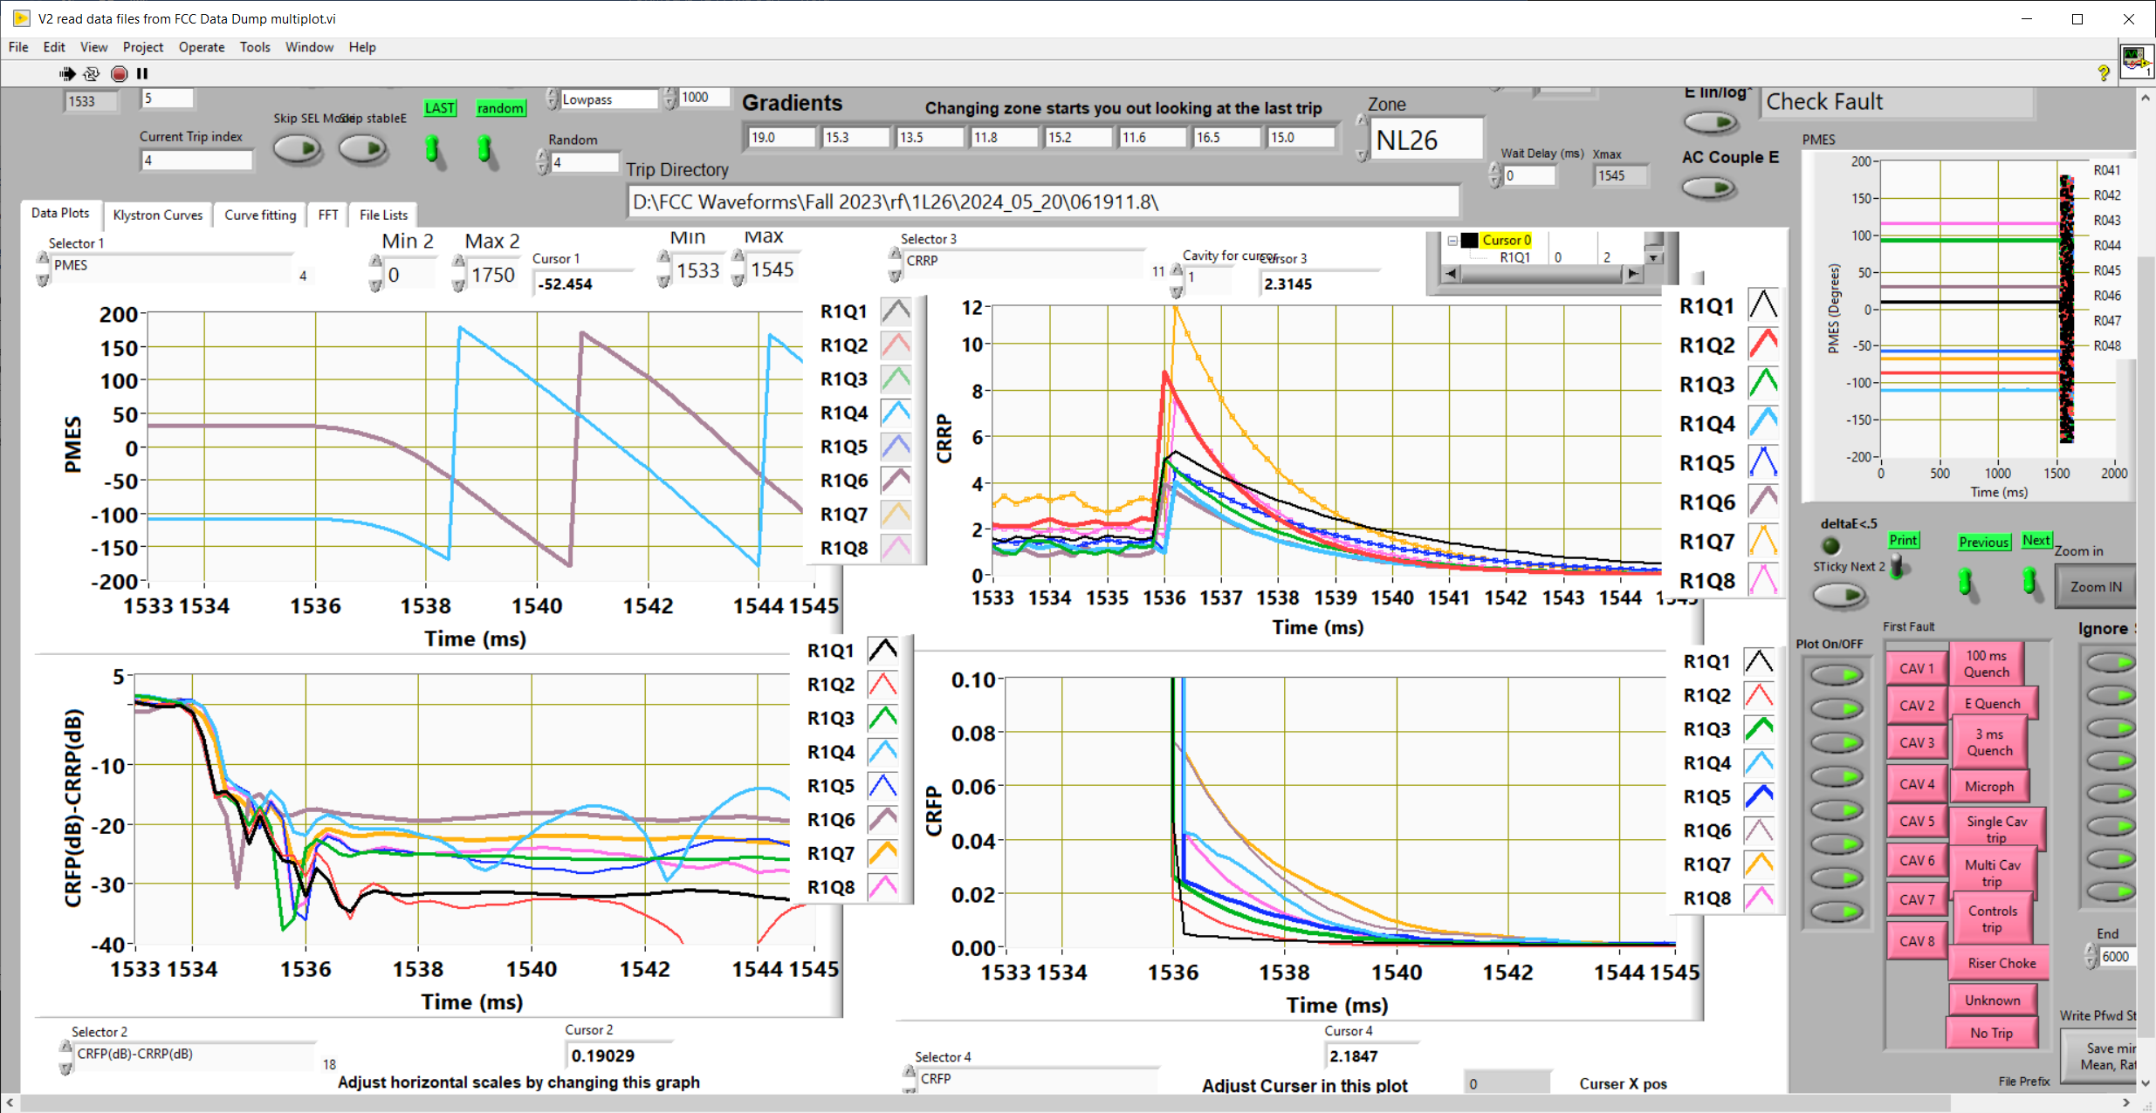
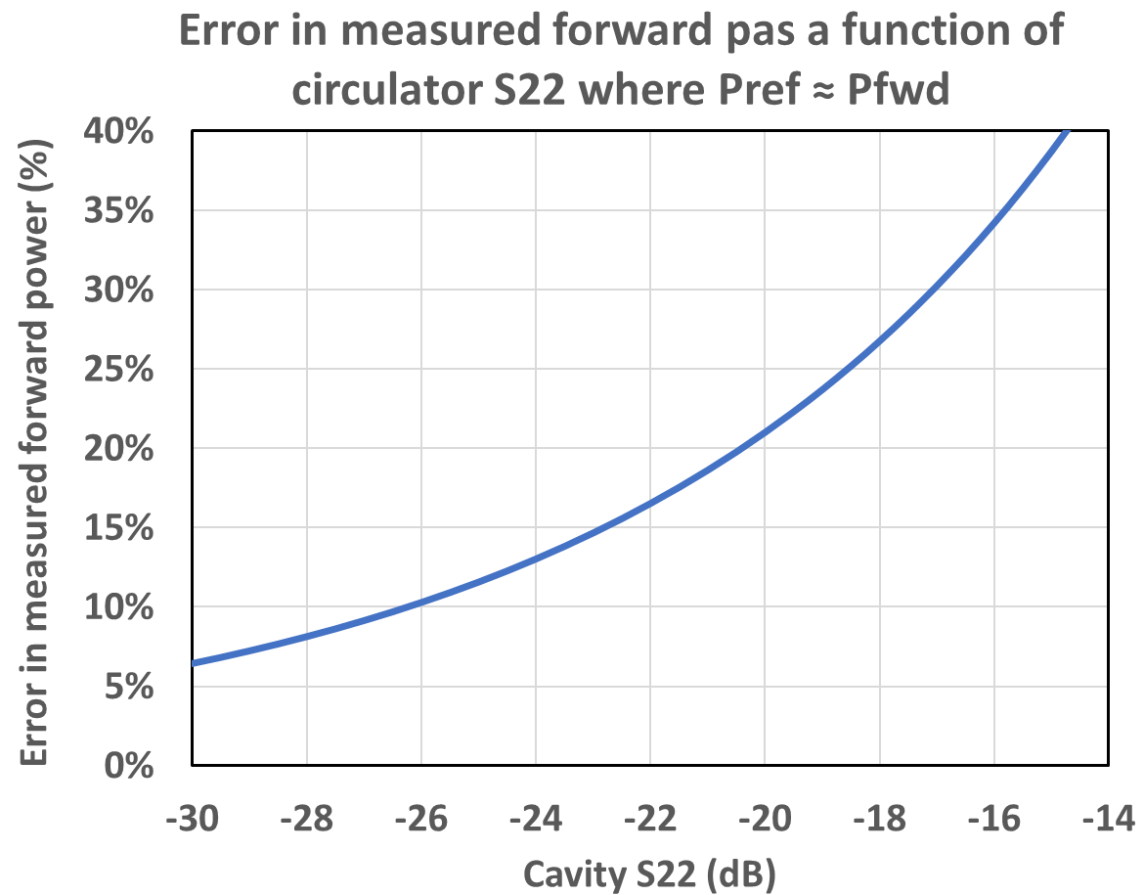
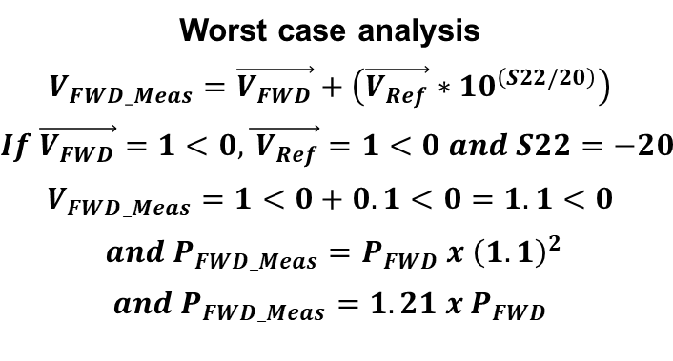
Using the waveforms to measure directivity of circulator and directional coupler
Worst case analysis
$$V_{FWD_Meas}=\vec{V_{FWD}}+\left(\vec{V_{Ref}}∗10^{\left(S22/20\right)}\right)$$
$$If \vec{V_{FWD}}=1<0, \vec{{ V}_{Ref}}=1<0 and S22=−20$$
$$V_{FWD_Meas}=1<0+0.1<0=1.1<0$$
$${and P}_{FWD_Meas}=P_{FWD} x {\left(1.1\right)}^{2}$$
$${and P}_{FWD_Meas}={1.21 x P}_{FWD}$$
When you turn off the RF the emitted power from the cavity travels back down the waveguide and some of it is reflected off of the output of the circulator.
The difference between the Pfwd and Pref (in dBm) provides the combination of the directivity of the circulator and the forward power coupler.
This directivity introduce a phase dependent error in the forward power which can be substantial.

